Slide 1
Underwood Memorial Baptist Church 175 Years
By Pastor Jason & Brice Smith

Slide 2
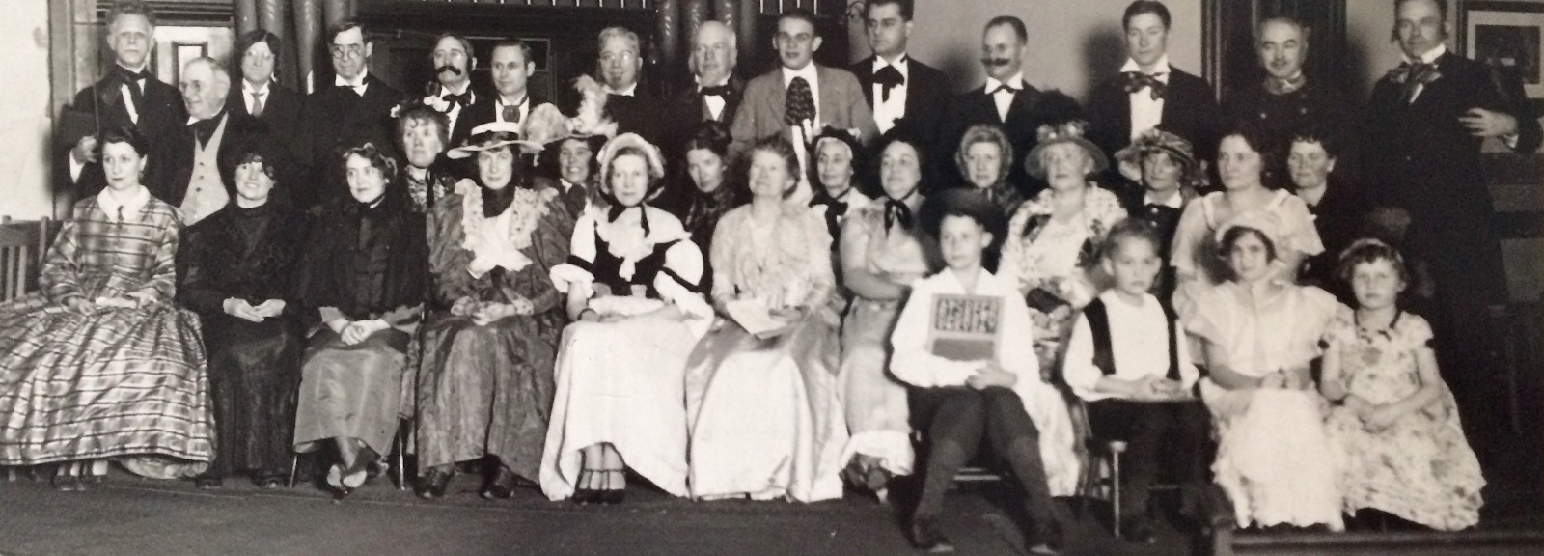
On October 11, 1845, thirty-one charter members started what is now Underwood Memorial Baptist Church. White settlers had only been in the area for ten years and it would be another four years until Wisconsin became a state.

Slide 3
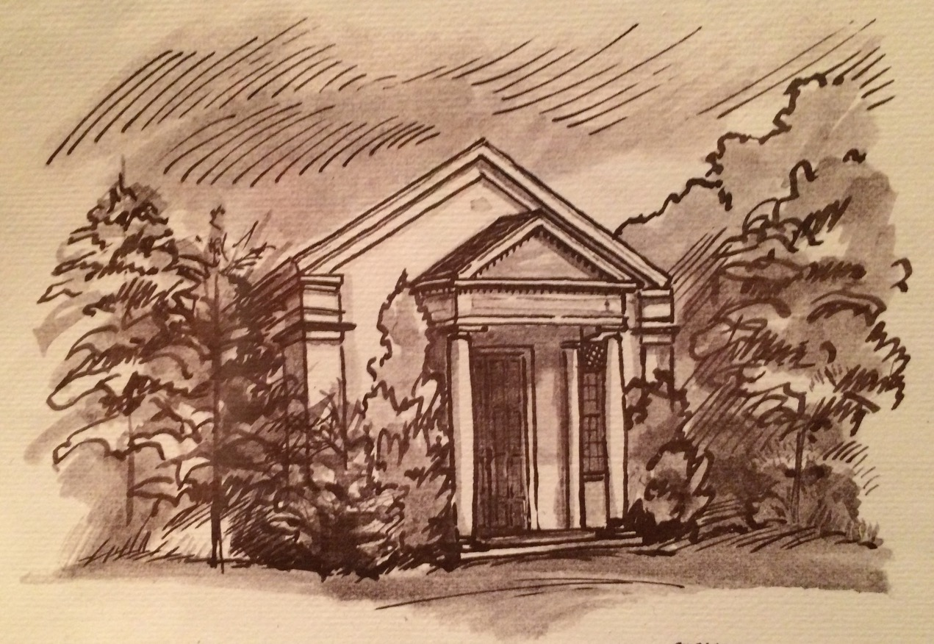
Sketch of Underwood’s First Building

Slide 4
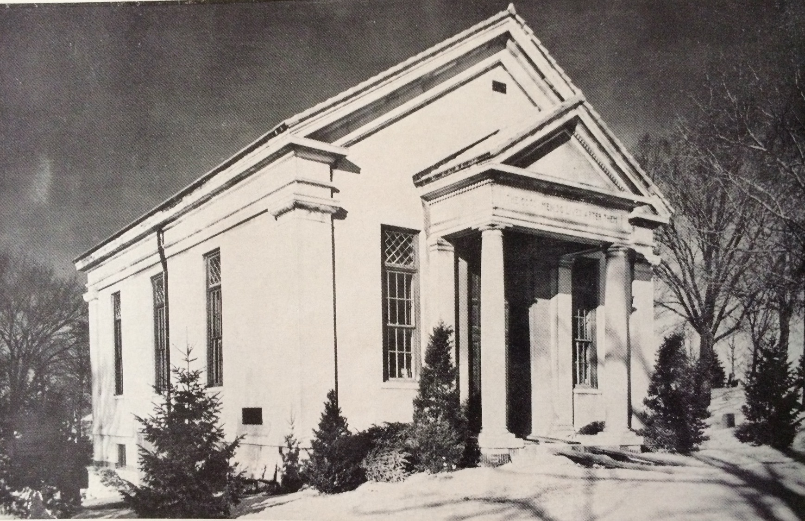
Underwood’s first building – the first church building erected in Wauwatosa.

Slide 5
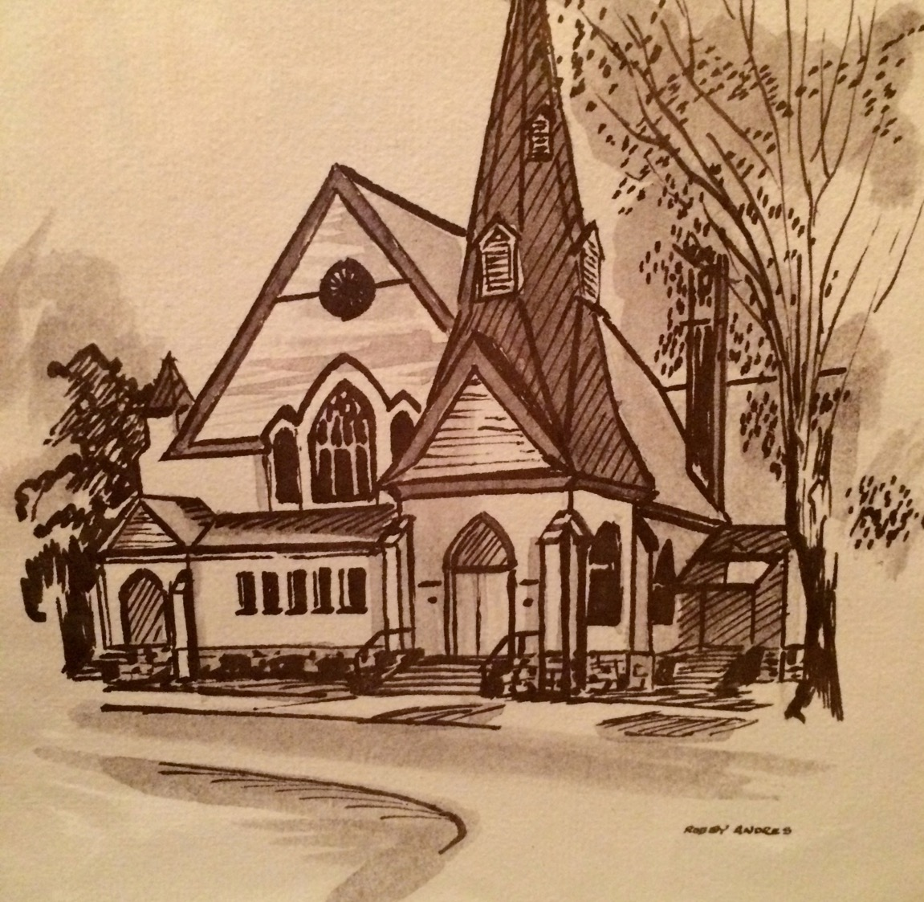
Sketch of Underwood’s Second Building (across the street)

Slide 6
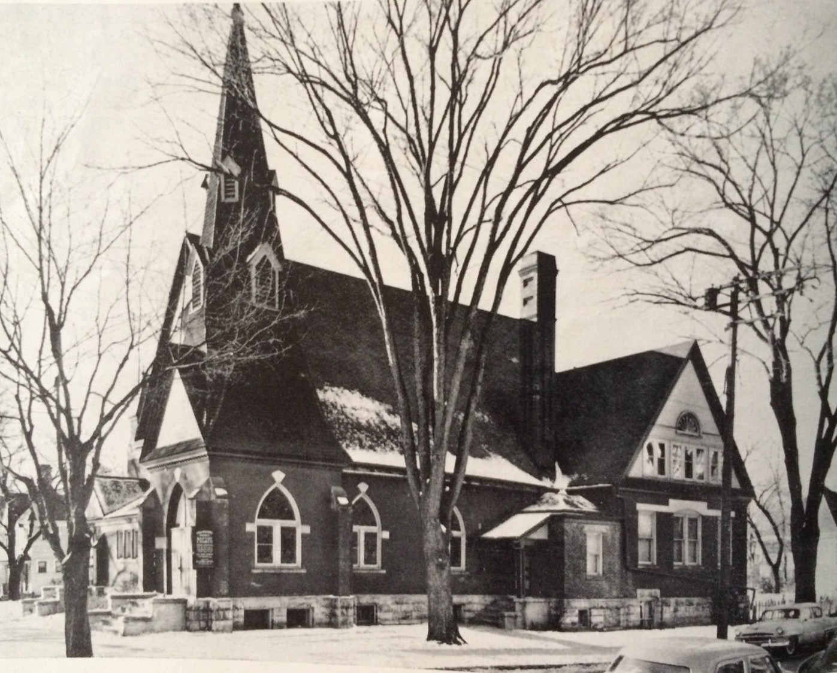

Slide 7
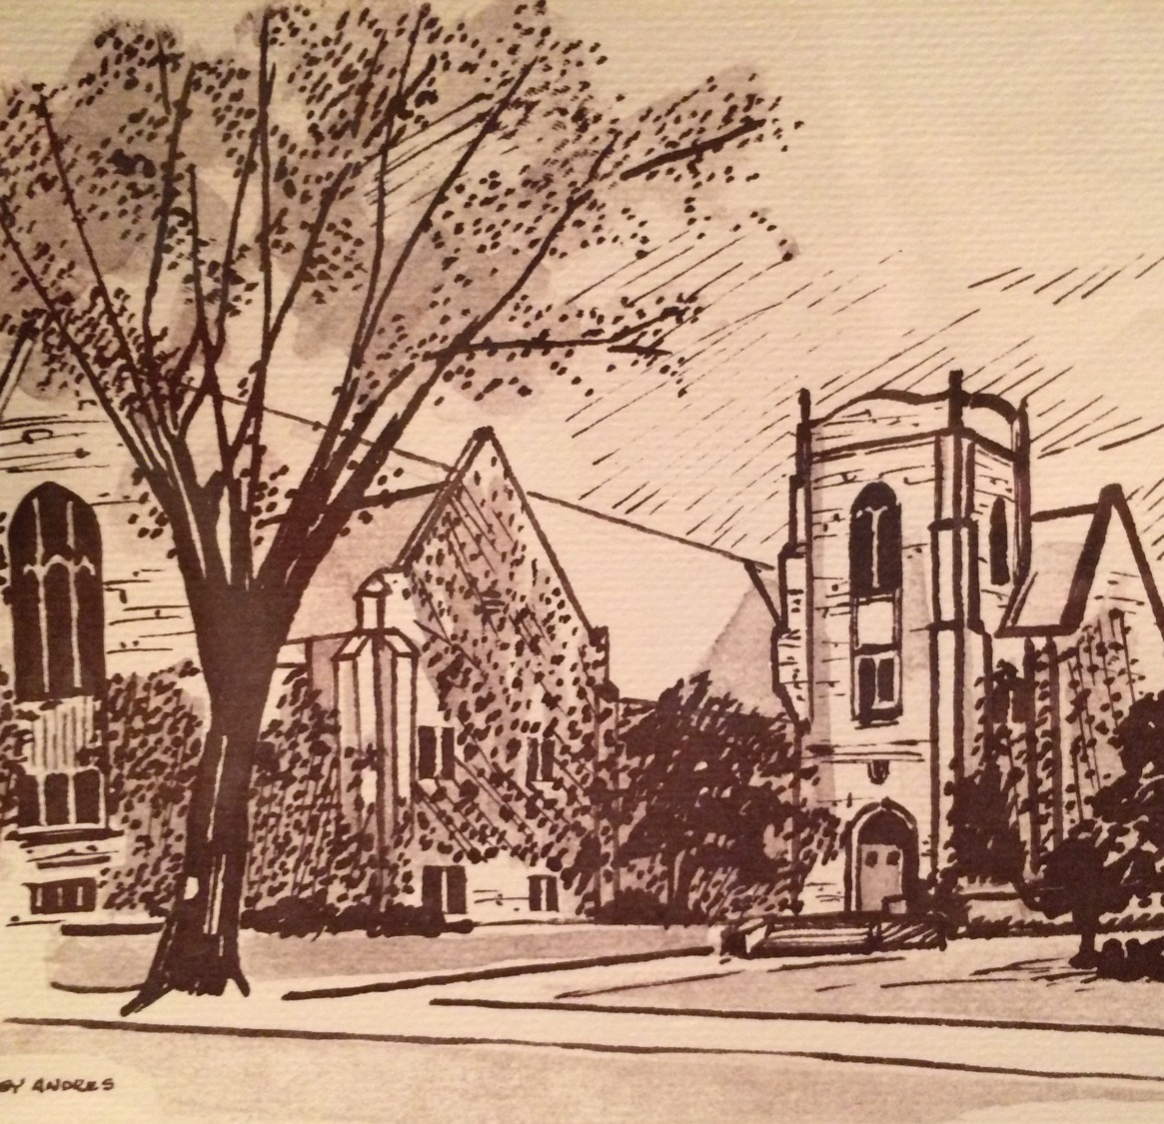
Sketch of the current building

Slide 8
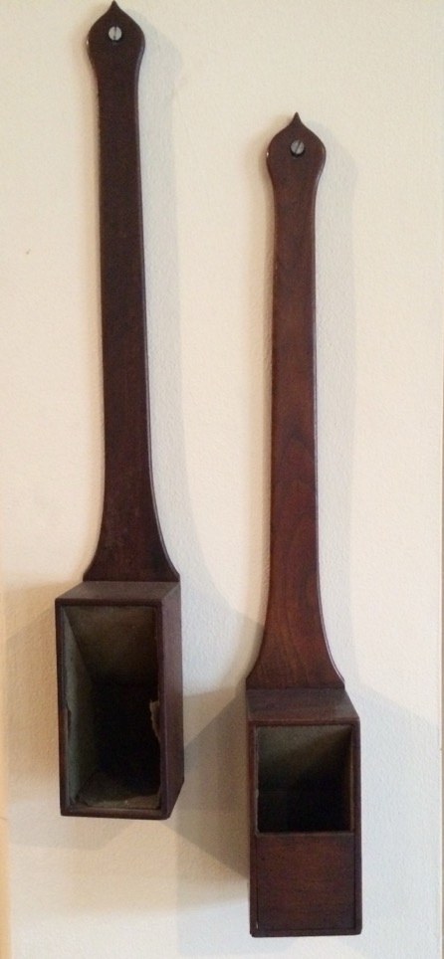
First Collection Boxes

Slide 9
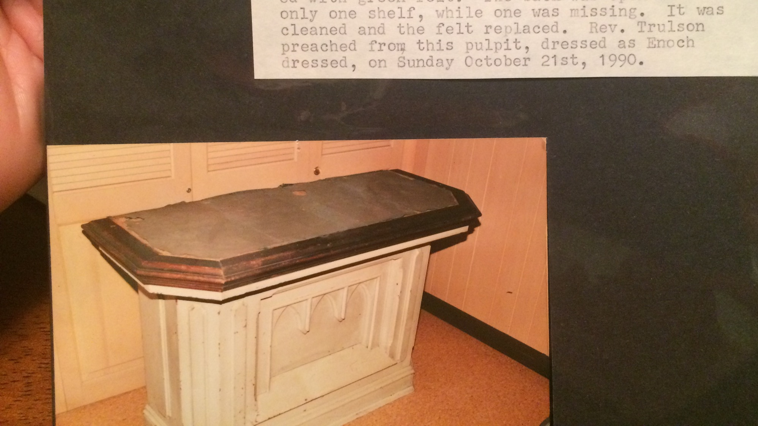
Original pulpit used by Elder Underwood c. 1850

Slide 10
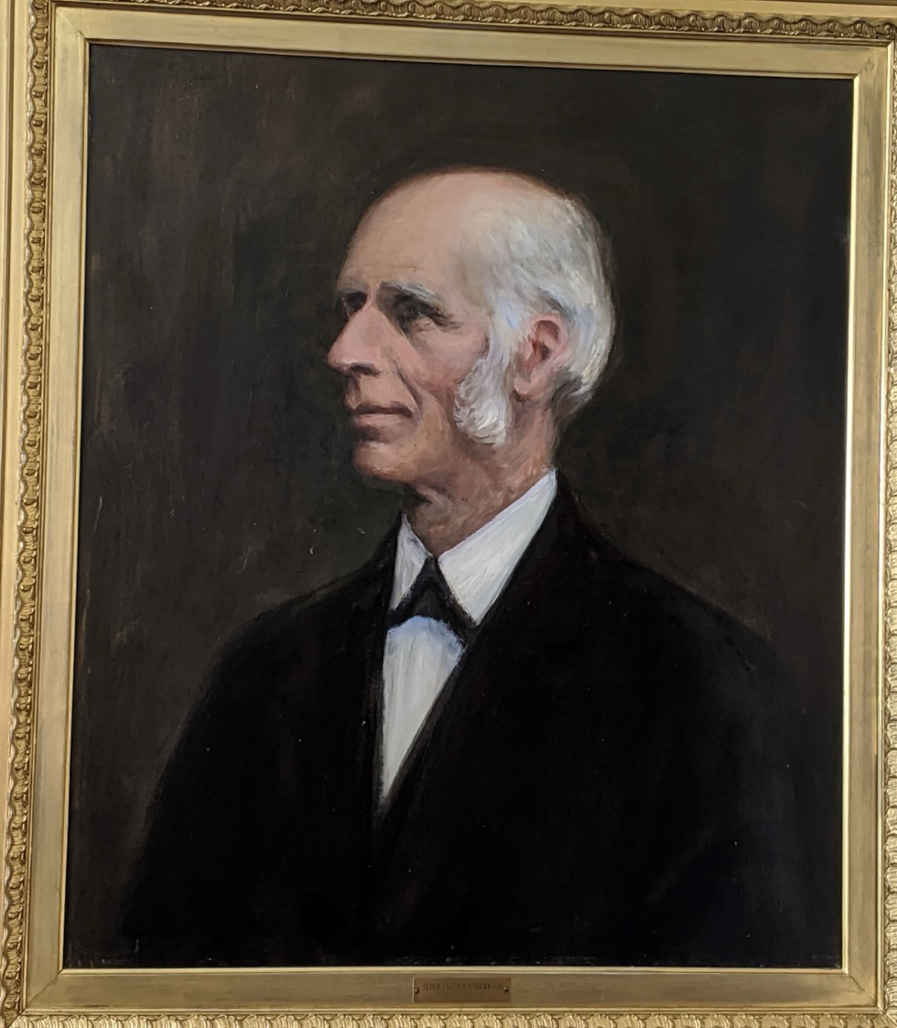
In 1849, the church ordained its first pastor: Enoch Underwood.
He served as pastor for thirty-eight years.
Enoch was the leader of the Underground Railroad in what is now Wauwatosa.
He and his wife Harriet sheltered several individuals seeking freedom in Canada.

Slide 11
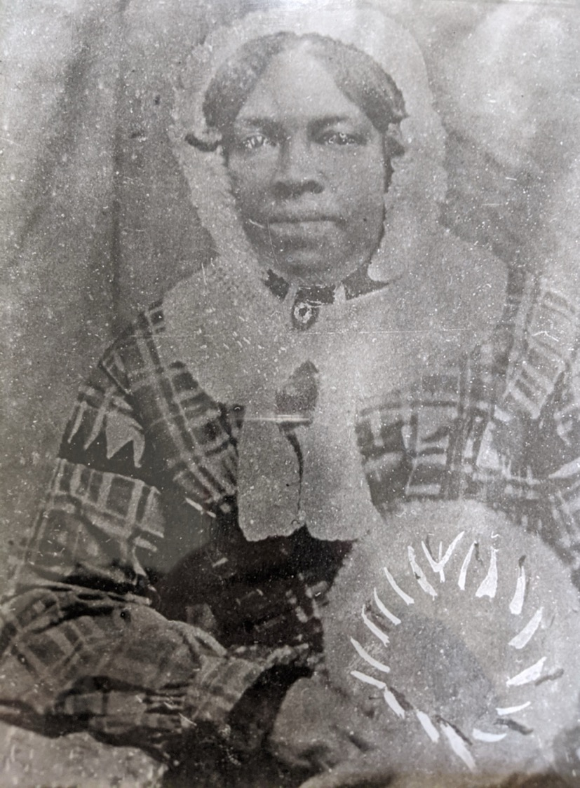
The Underwoods successfully helped conduct the first person along the Underground Railroad in southeastern Wisconsin. Her name was Caroline Quarles.
150 years later, descendants of Quarles and the Underwoods would be reunited by Underwood church members in honor of the church’s 150th anniversary.

Slide 12
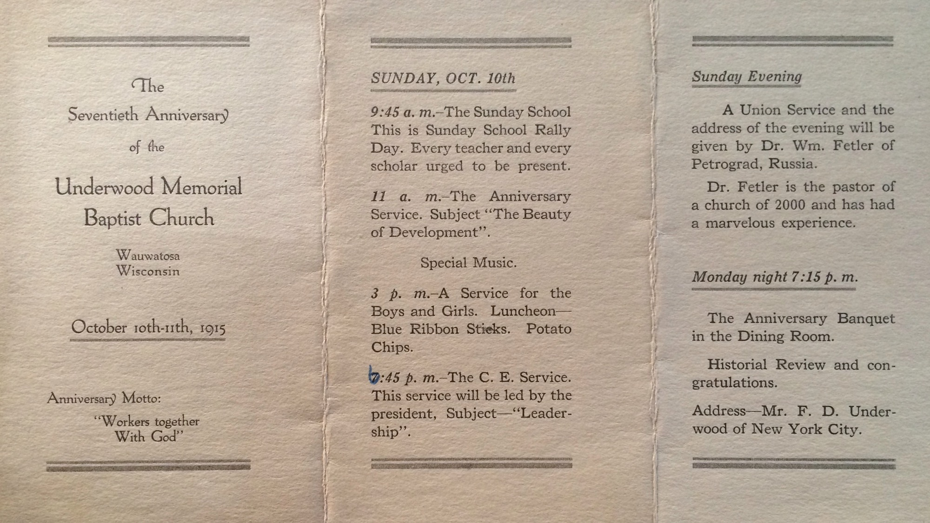
Bulletin from 1915

Slide 13
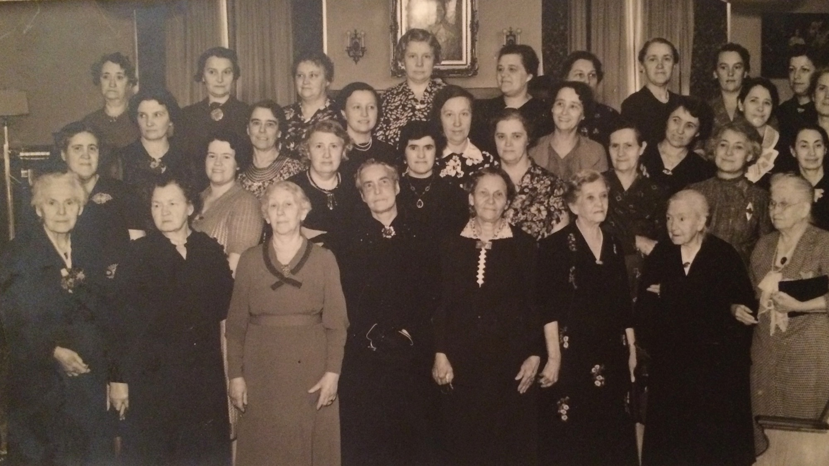
Underwood Women c. 1920

Slide 14
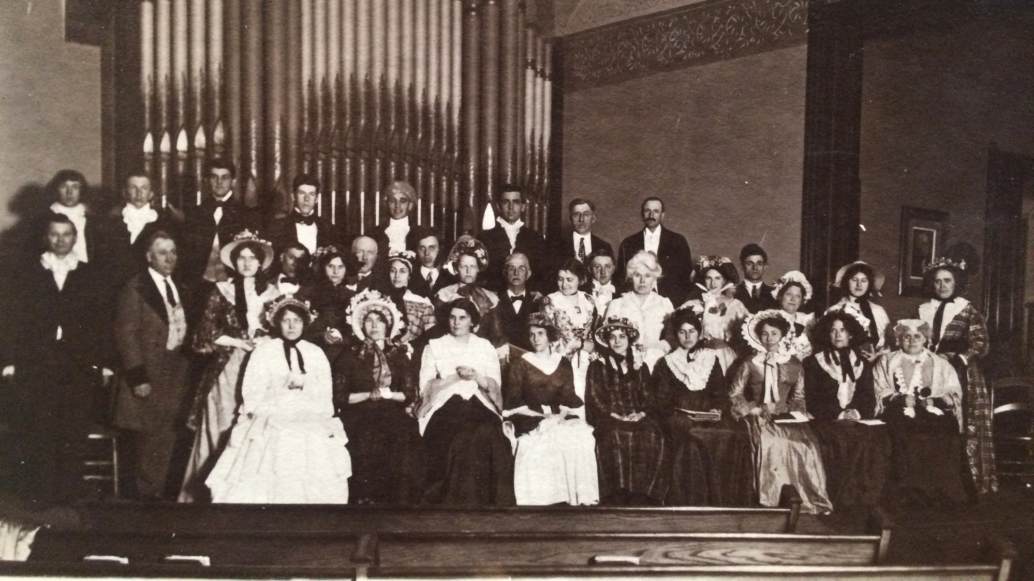
“The New Minister: A Musical Comedy”
Underwood 1921

Slide 15
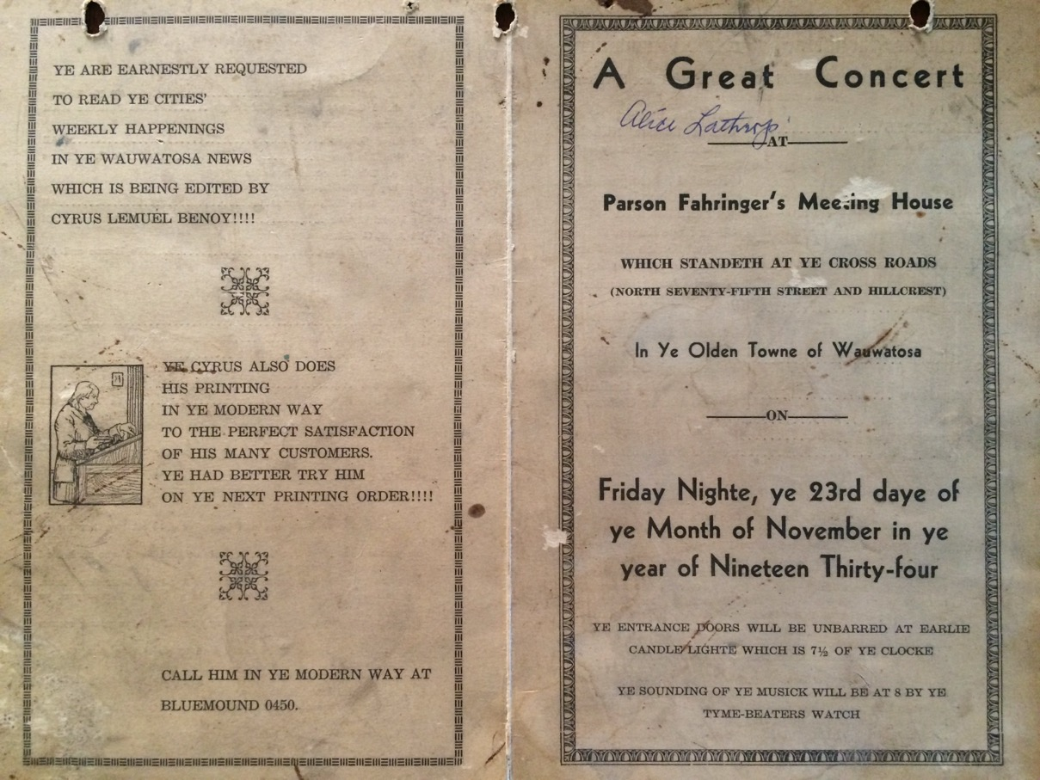
Program for “A Great Concert” 1934

Slide 16
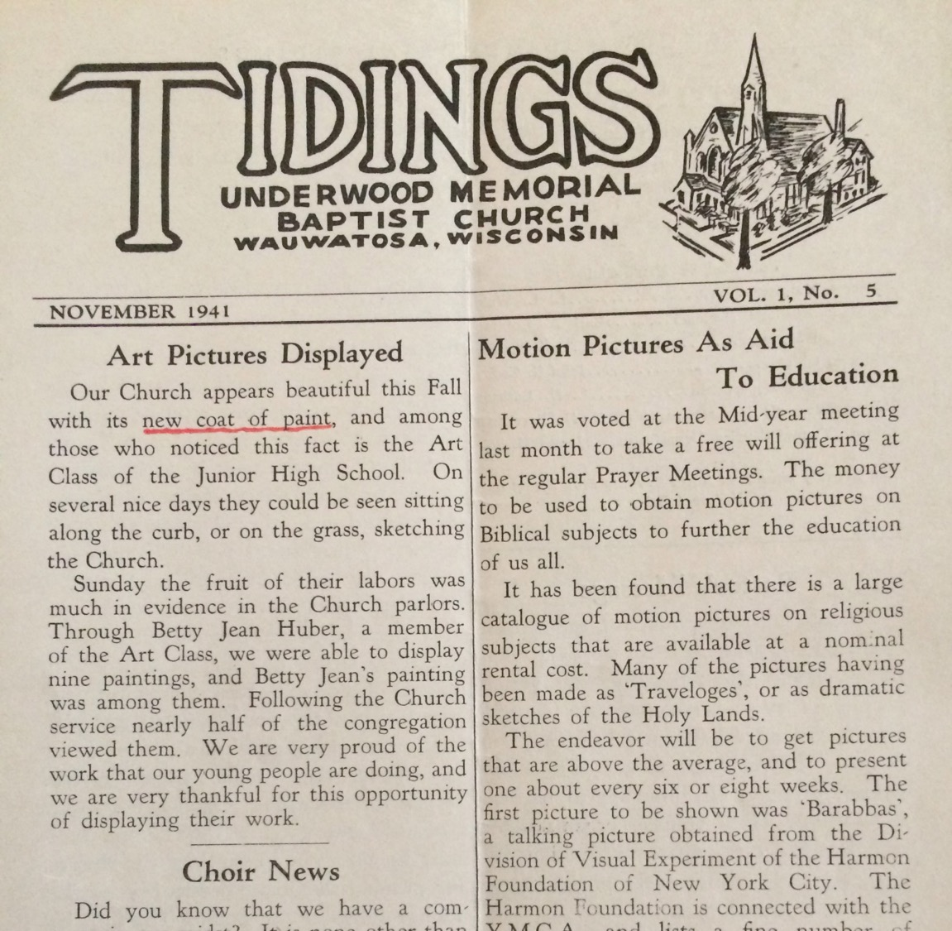
“Tidings” Underwood’s Newsletter Vol 1 No 5
Published in 1941

Slide 17
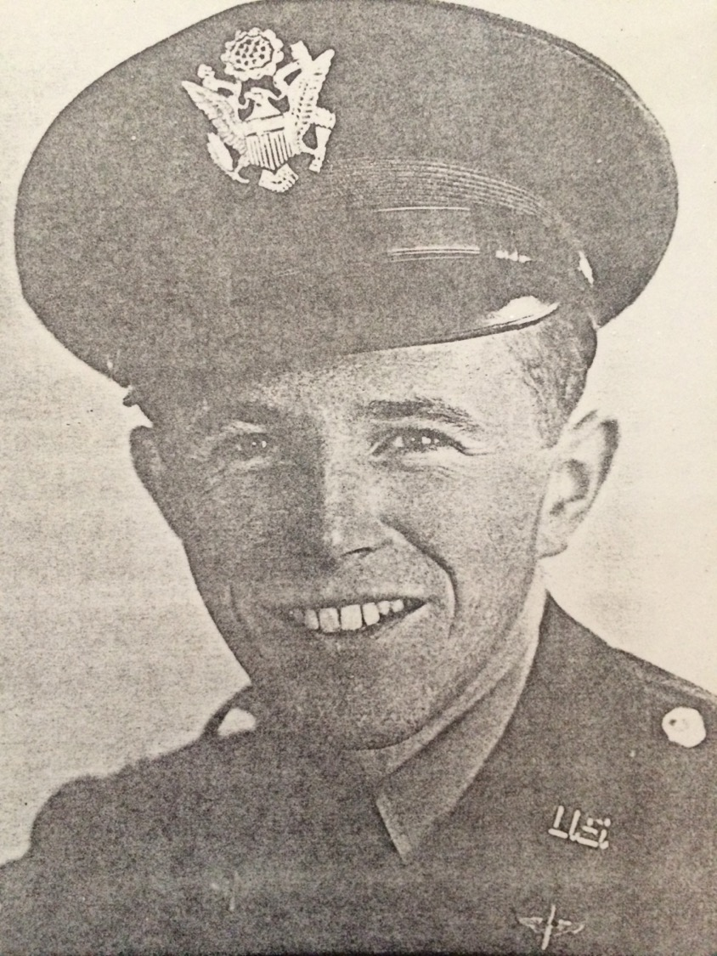
In 1943 Underwood member Lt. Sheldon died.
His parents donated the pulpits and communion table in his honor.

Slide 18
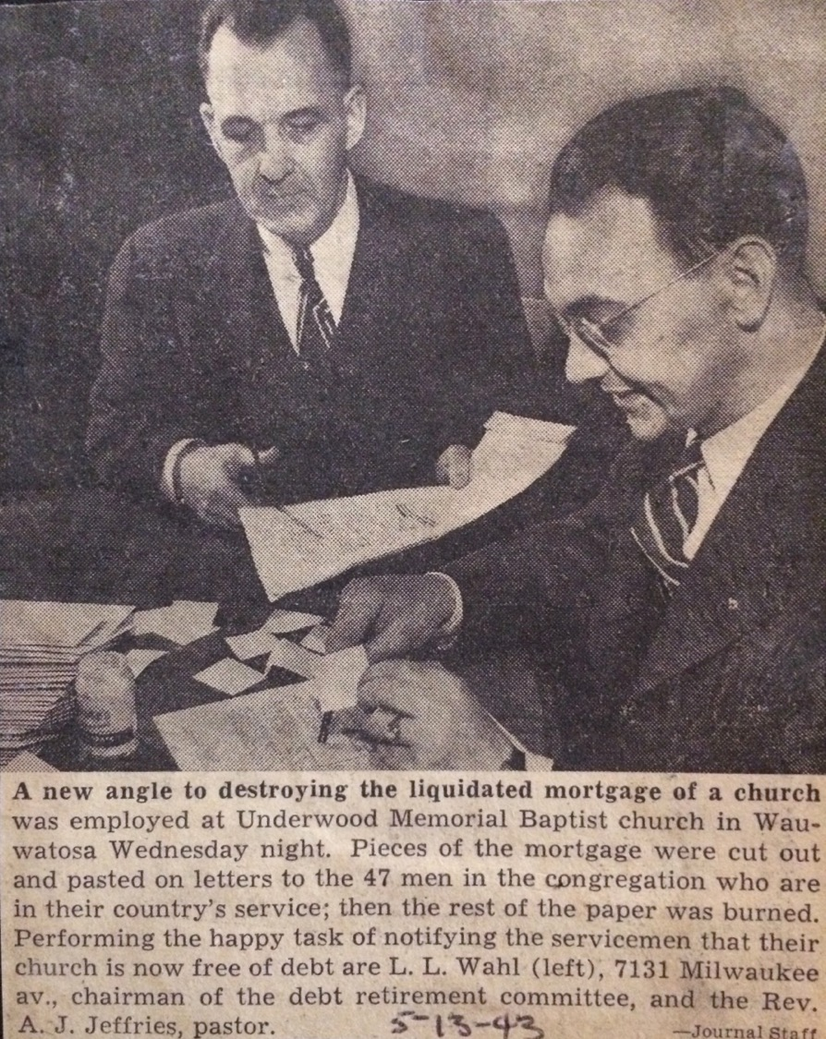
1943 mortgage burning made the local paper.

Slide 19
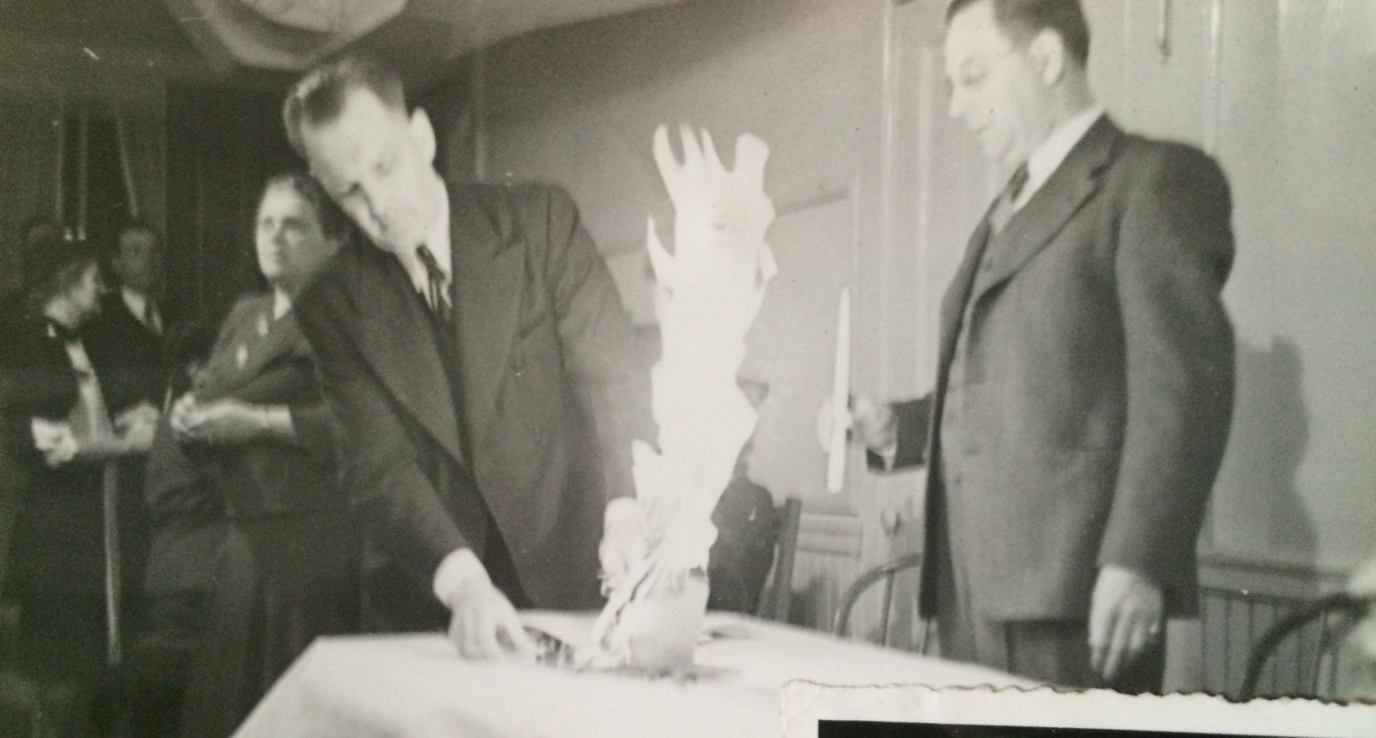

Slide 20
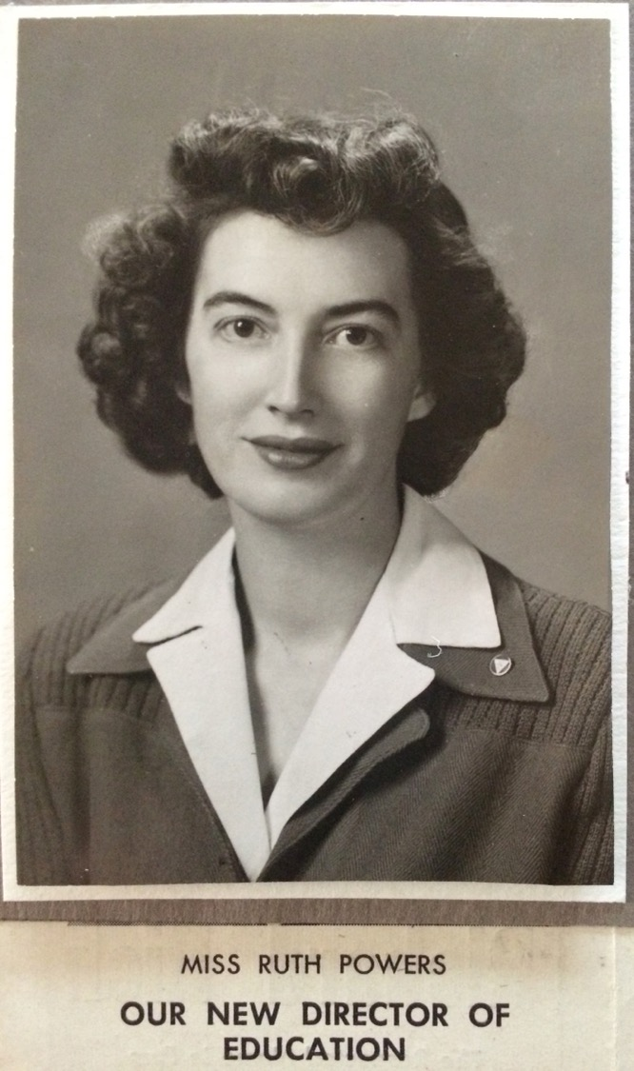
In 1944 Underwood hires its first female associate minister to be director of education.

Slide 21
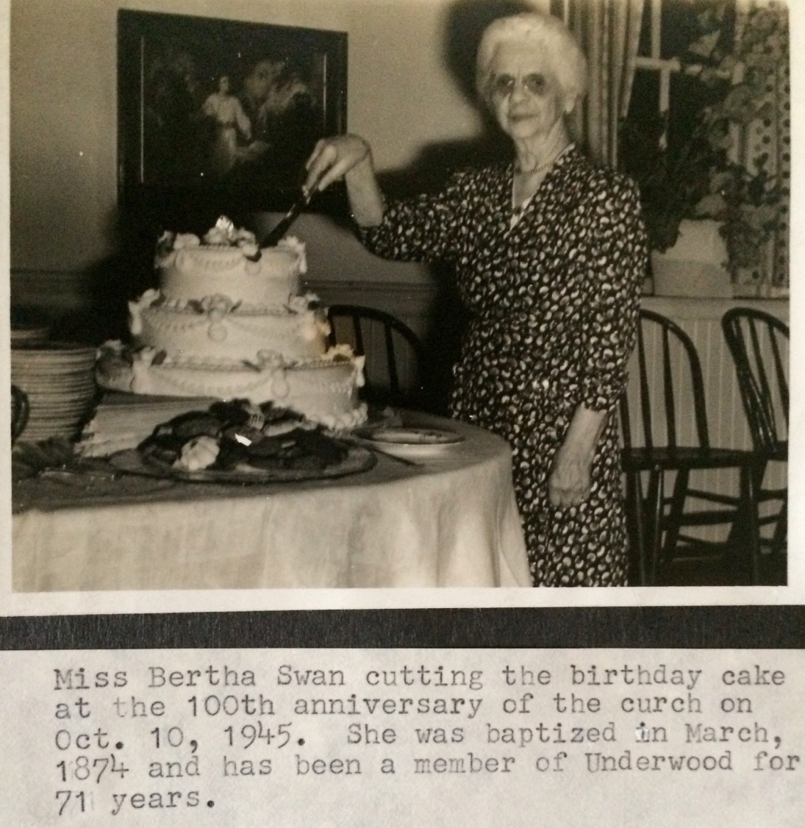
In 1945 Underwood celebrates it’s first 100 years of ministry.

Slide 22
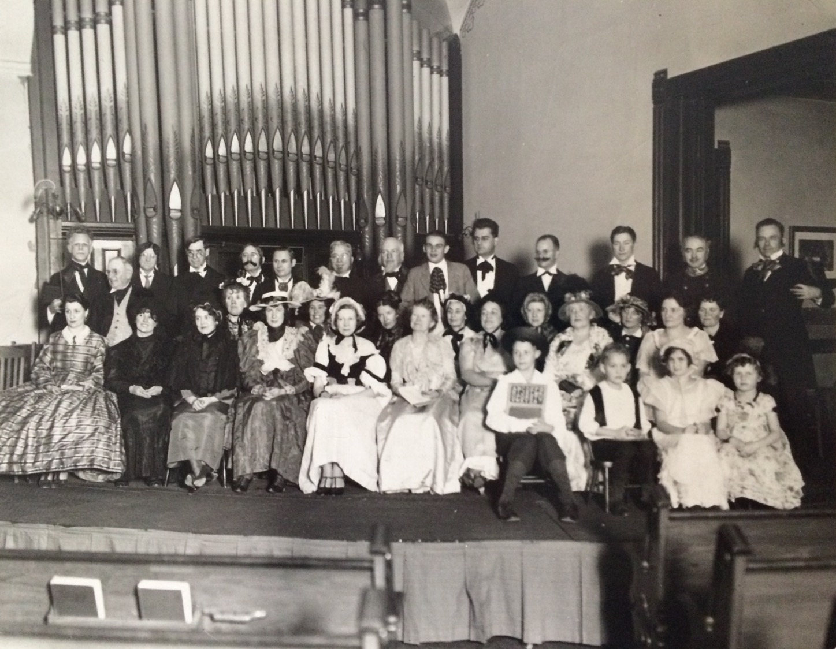
100th anniversary pageant

Slide 23
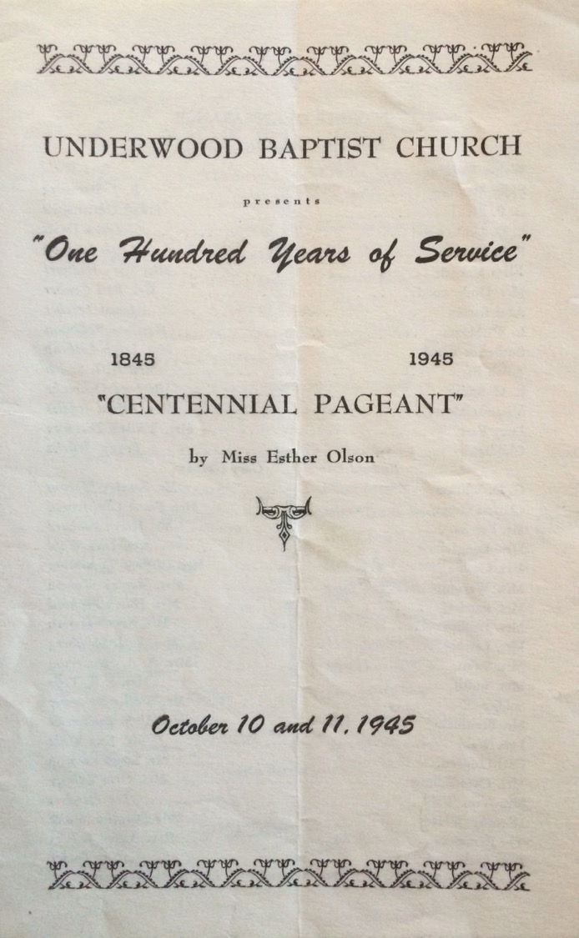

Slide 24
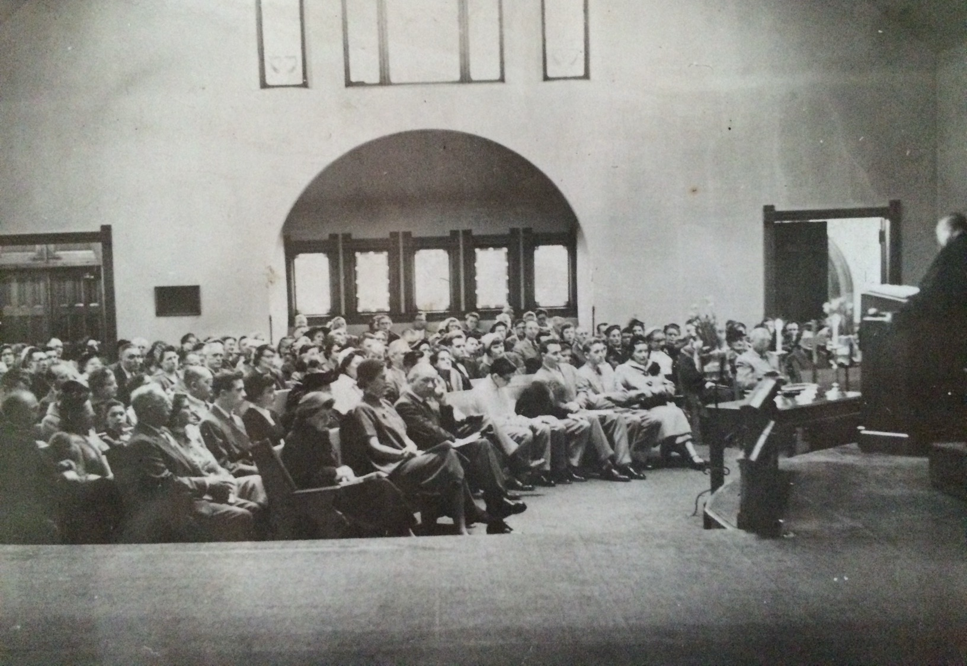
Underwood at worship, 1945

Slide 25
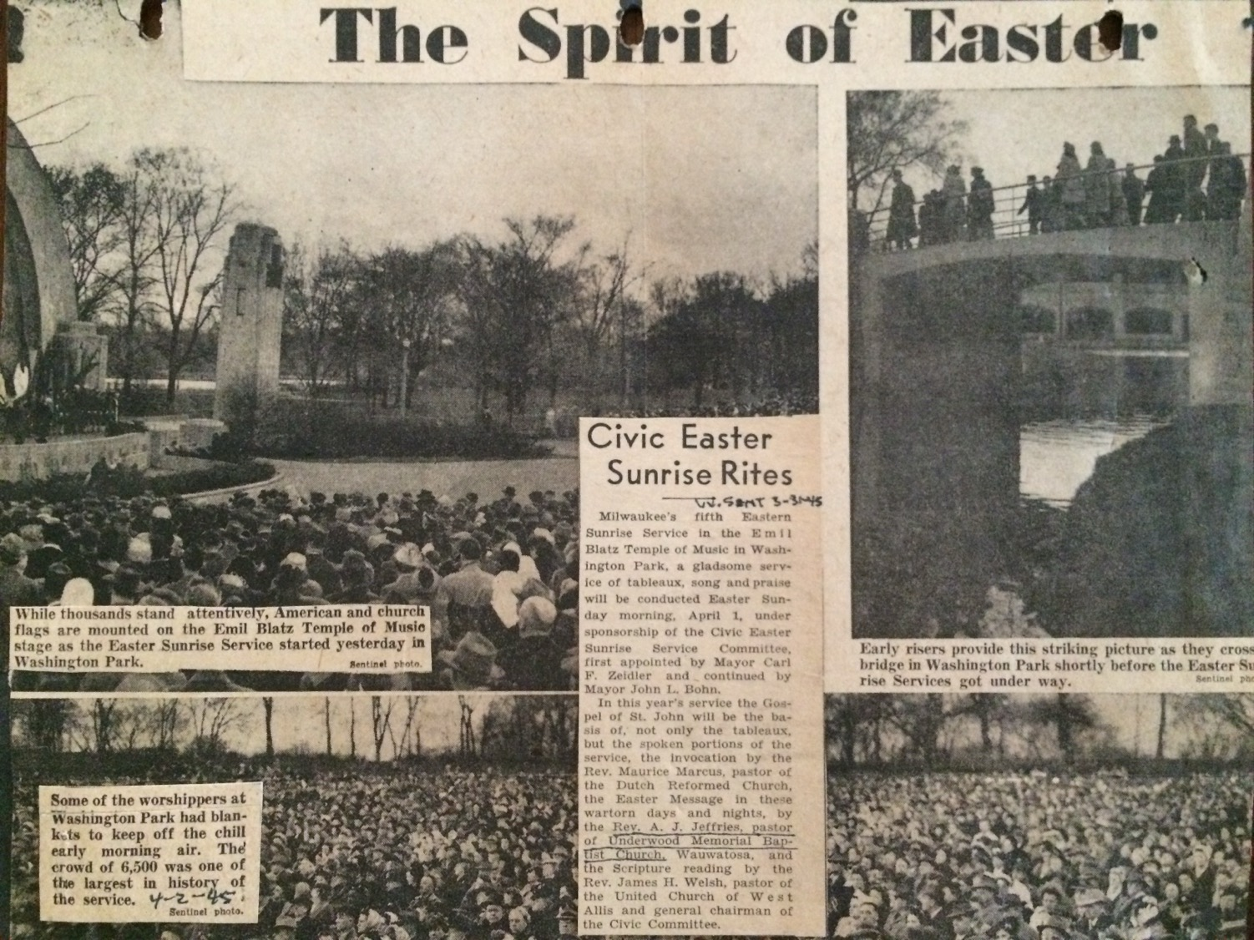
Public Easter Worship during wartime, 1945

Slide 26
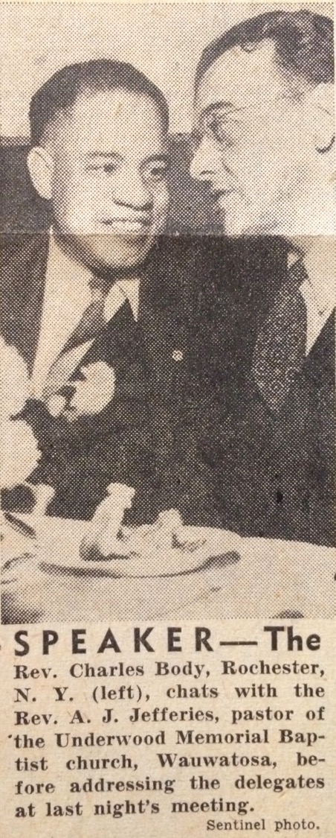
Rev. Charles Body (Rochester) and Rev. A. J. Jefferies (Underwood) at Baptist Annual Meeting, 1948.

Slide 27
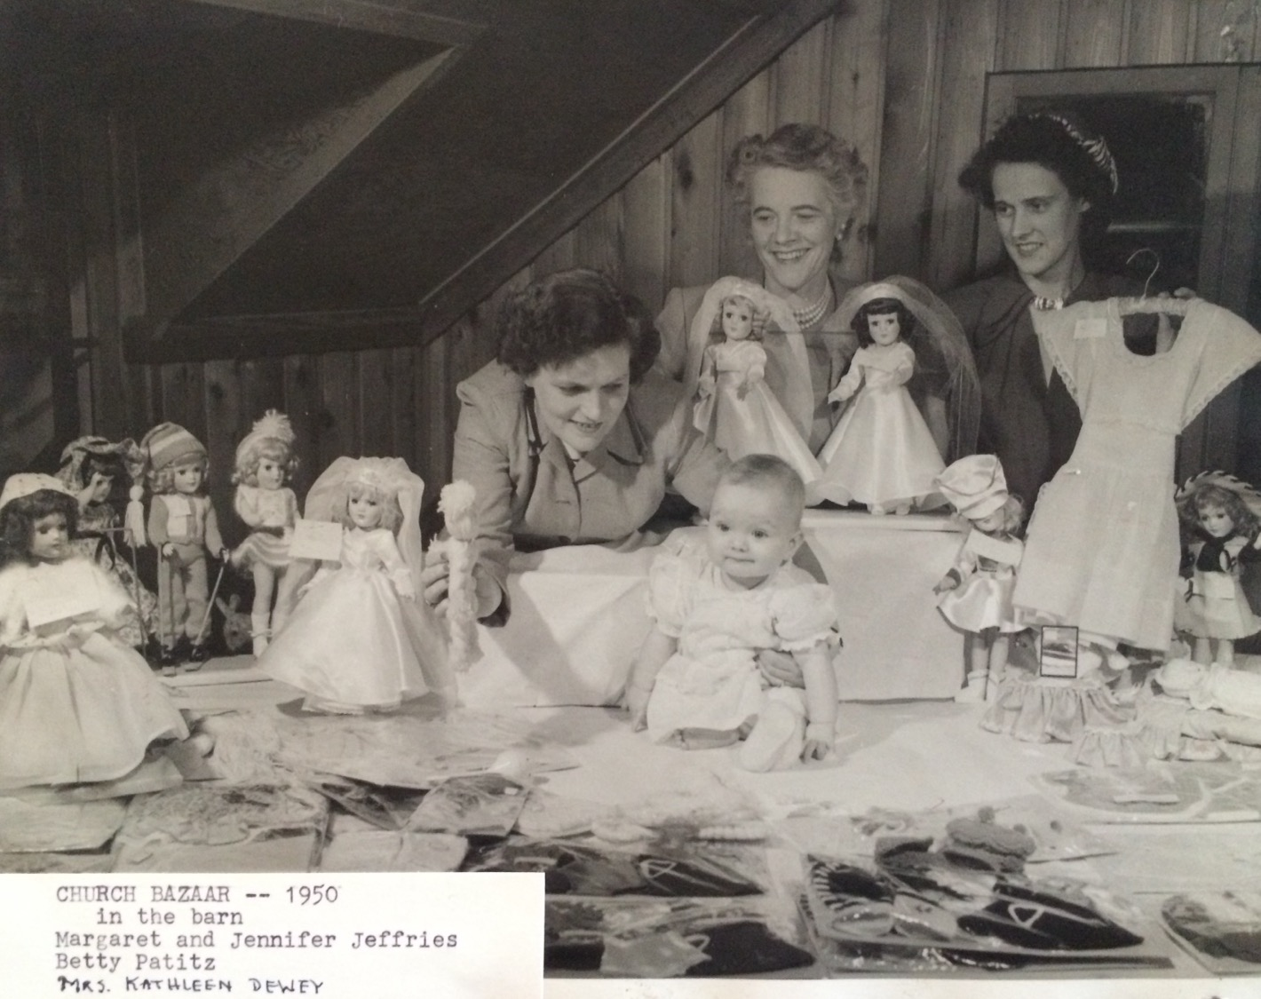
Church Bazar in the barn, 1950.

Slide 28
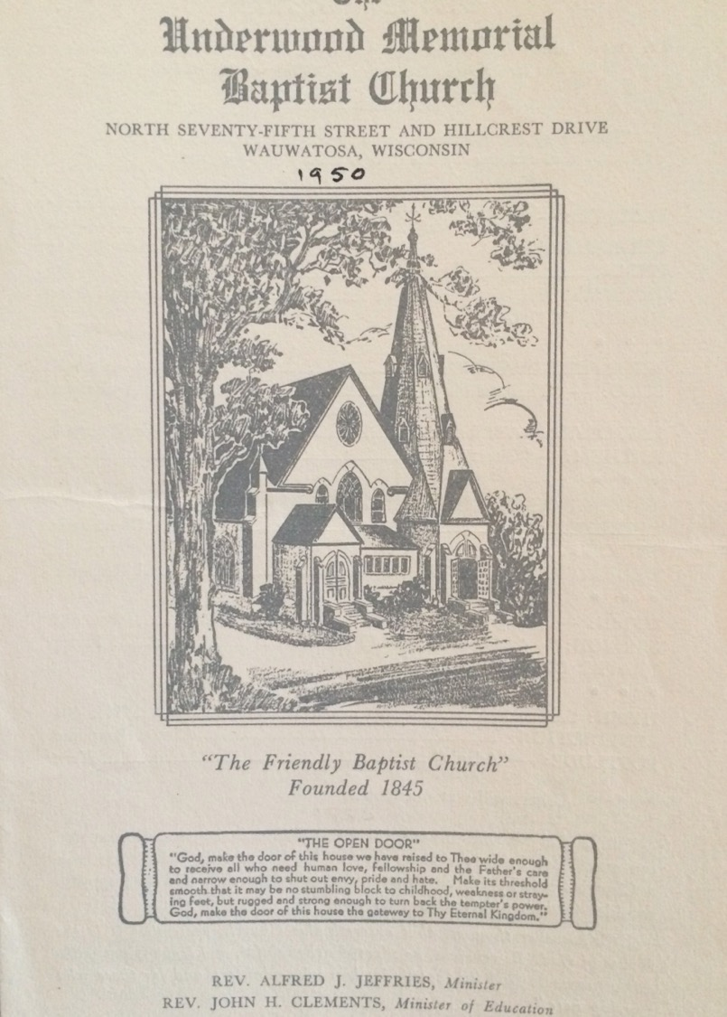
Church Bulletin, 1950
Tagline: “The Friendly Baptist Church”

Slide 29
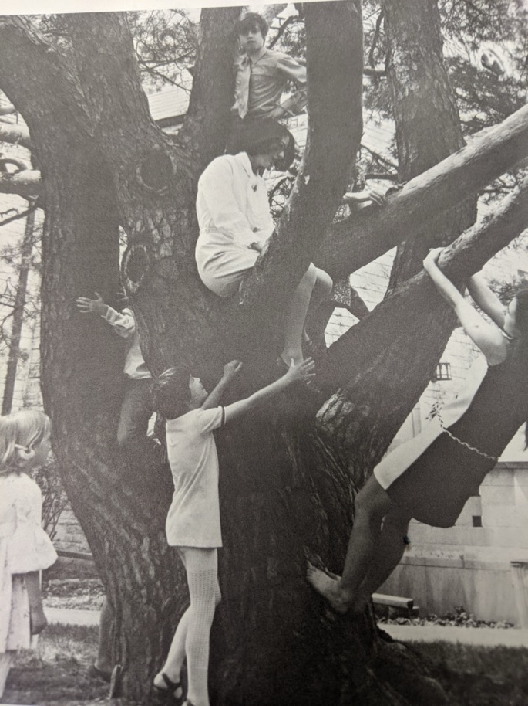

Slide 30
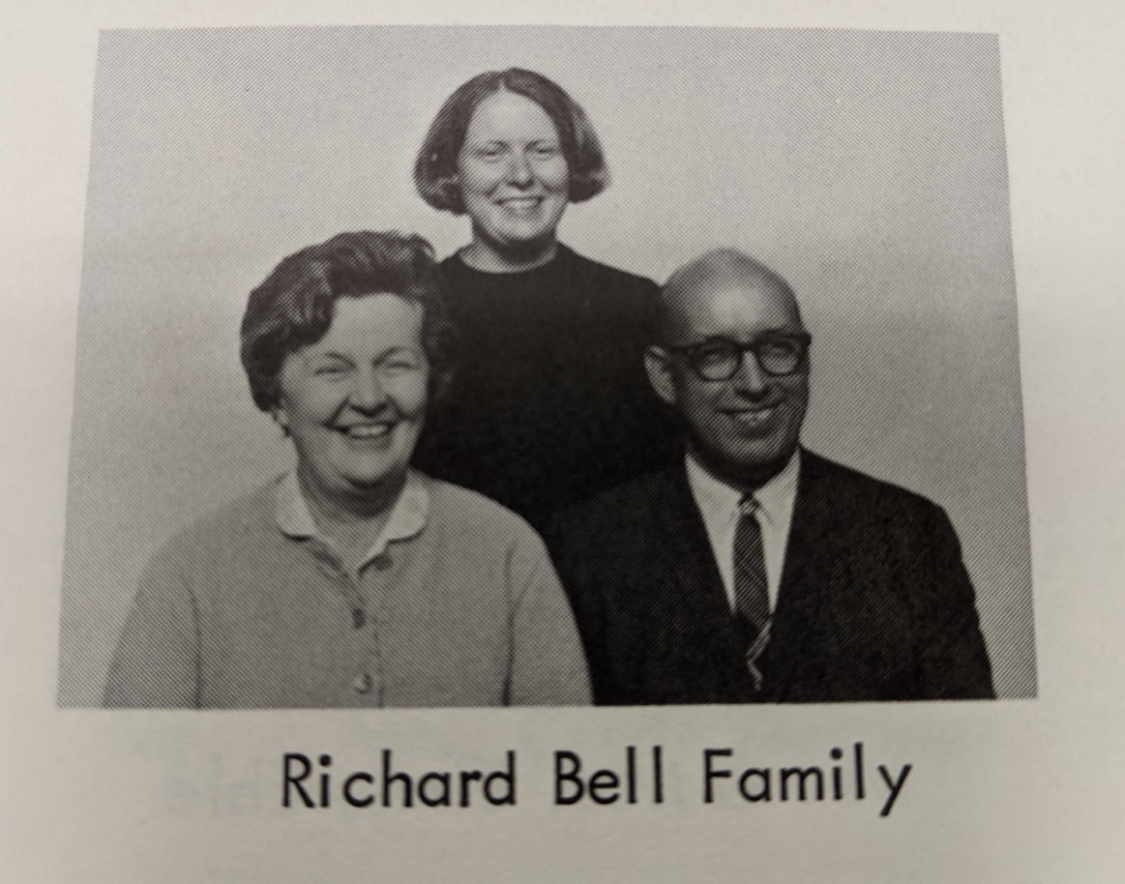

Slide 31
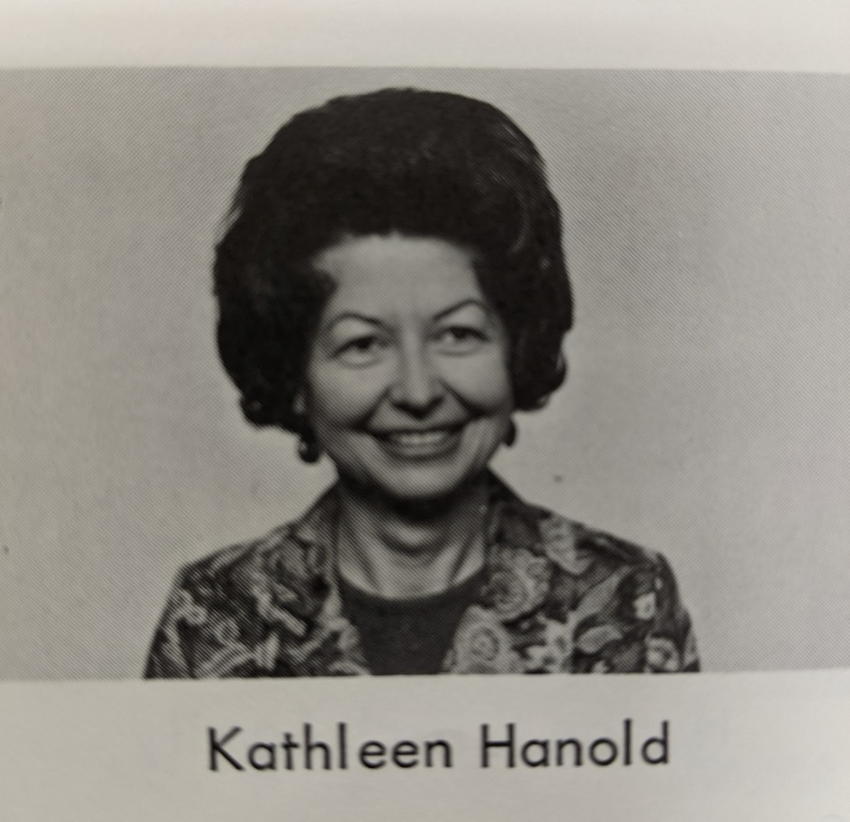

Slide 32
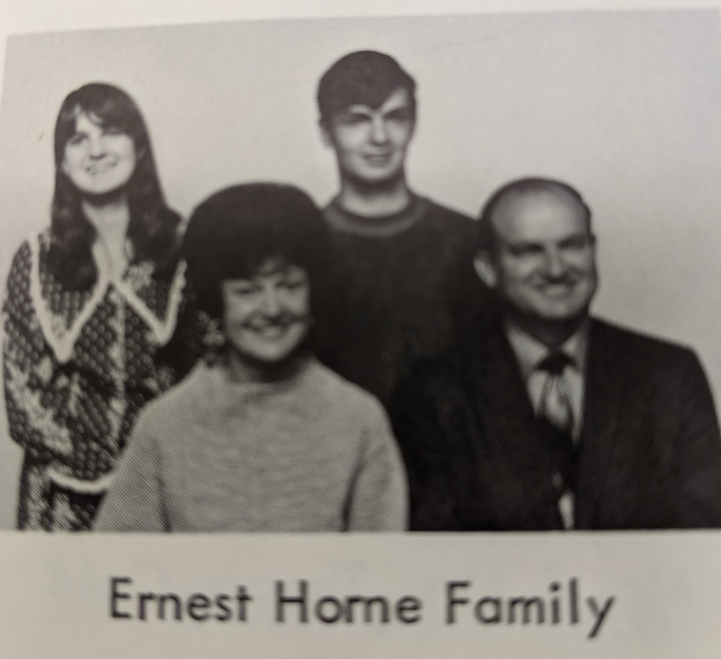

Slide 33
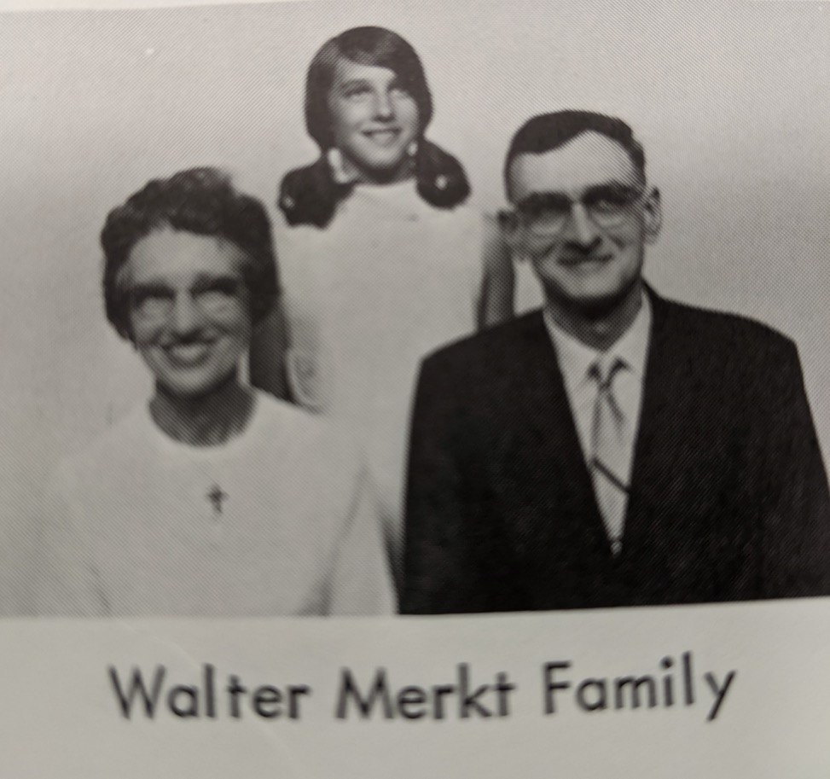

Slide 34
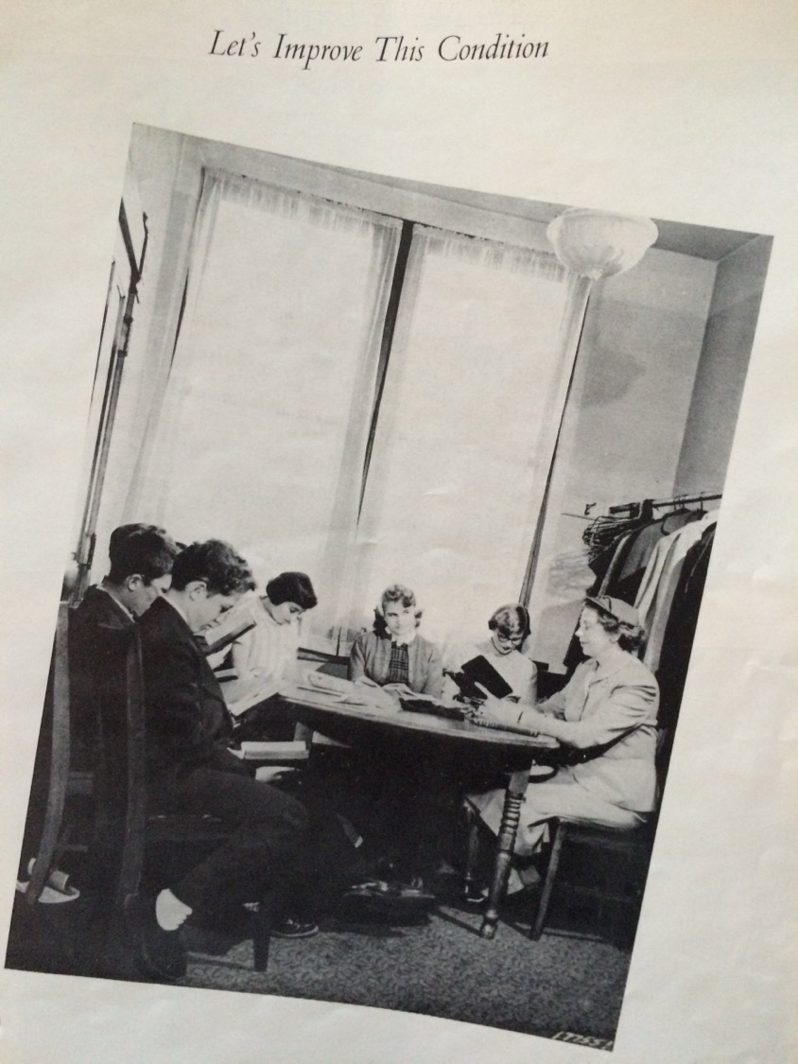
Making the case for the new building, 1952.

Slide 35
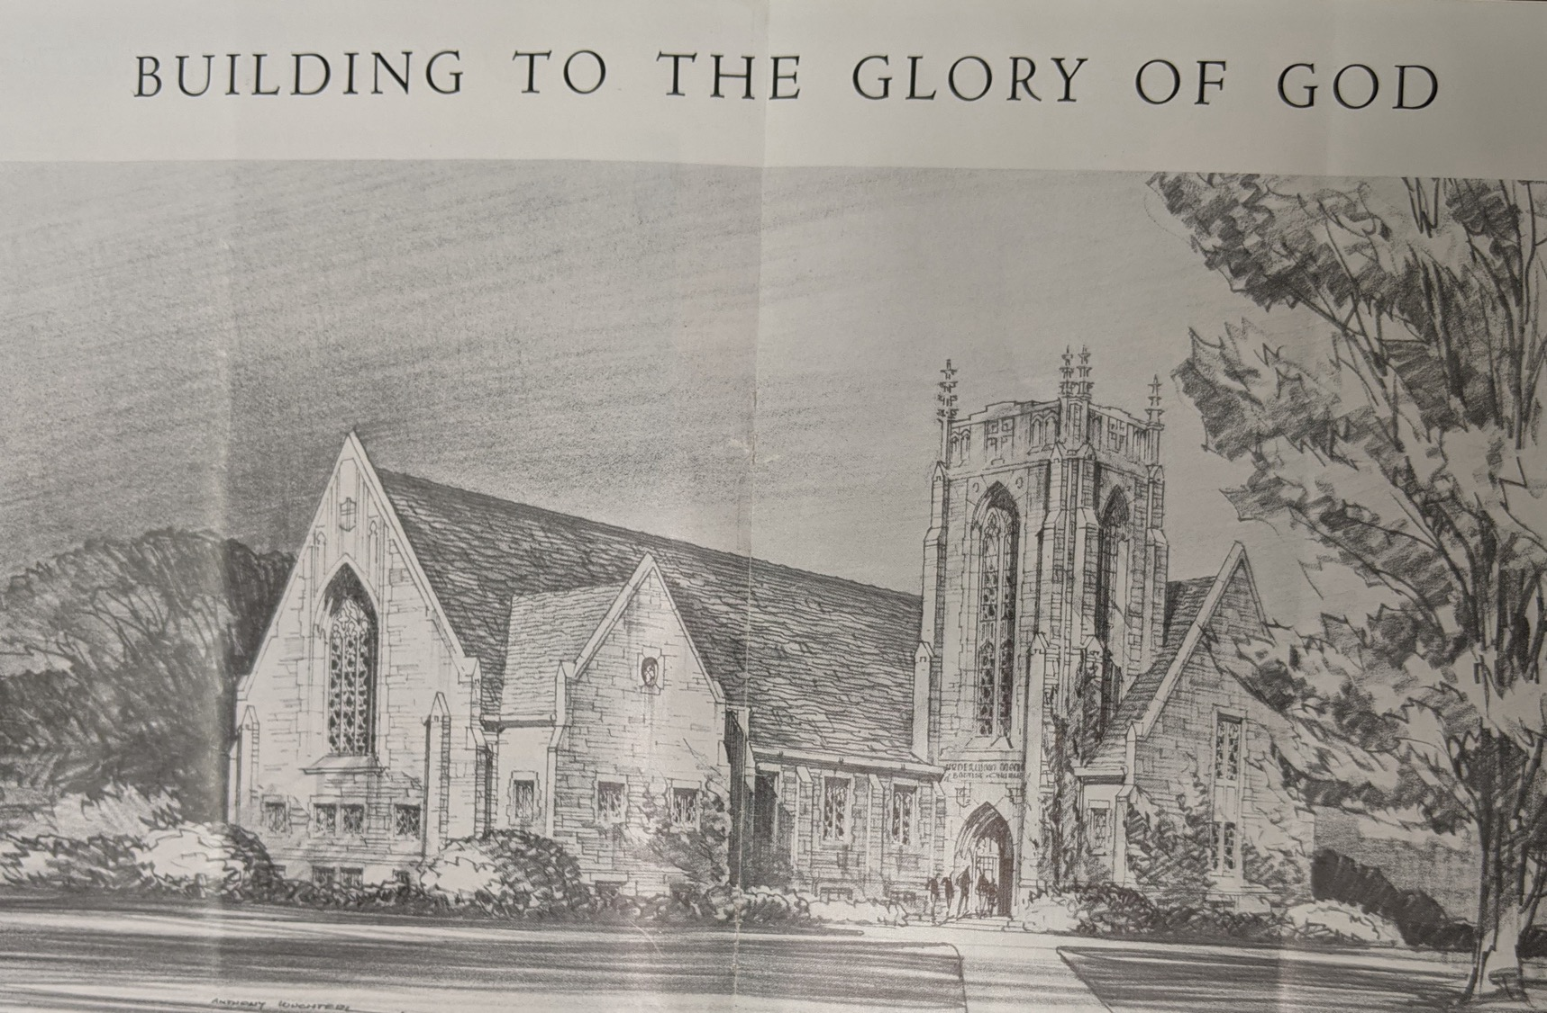

Slide 36
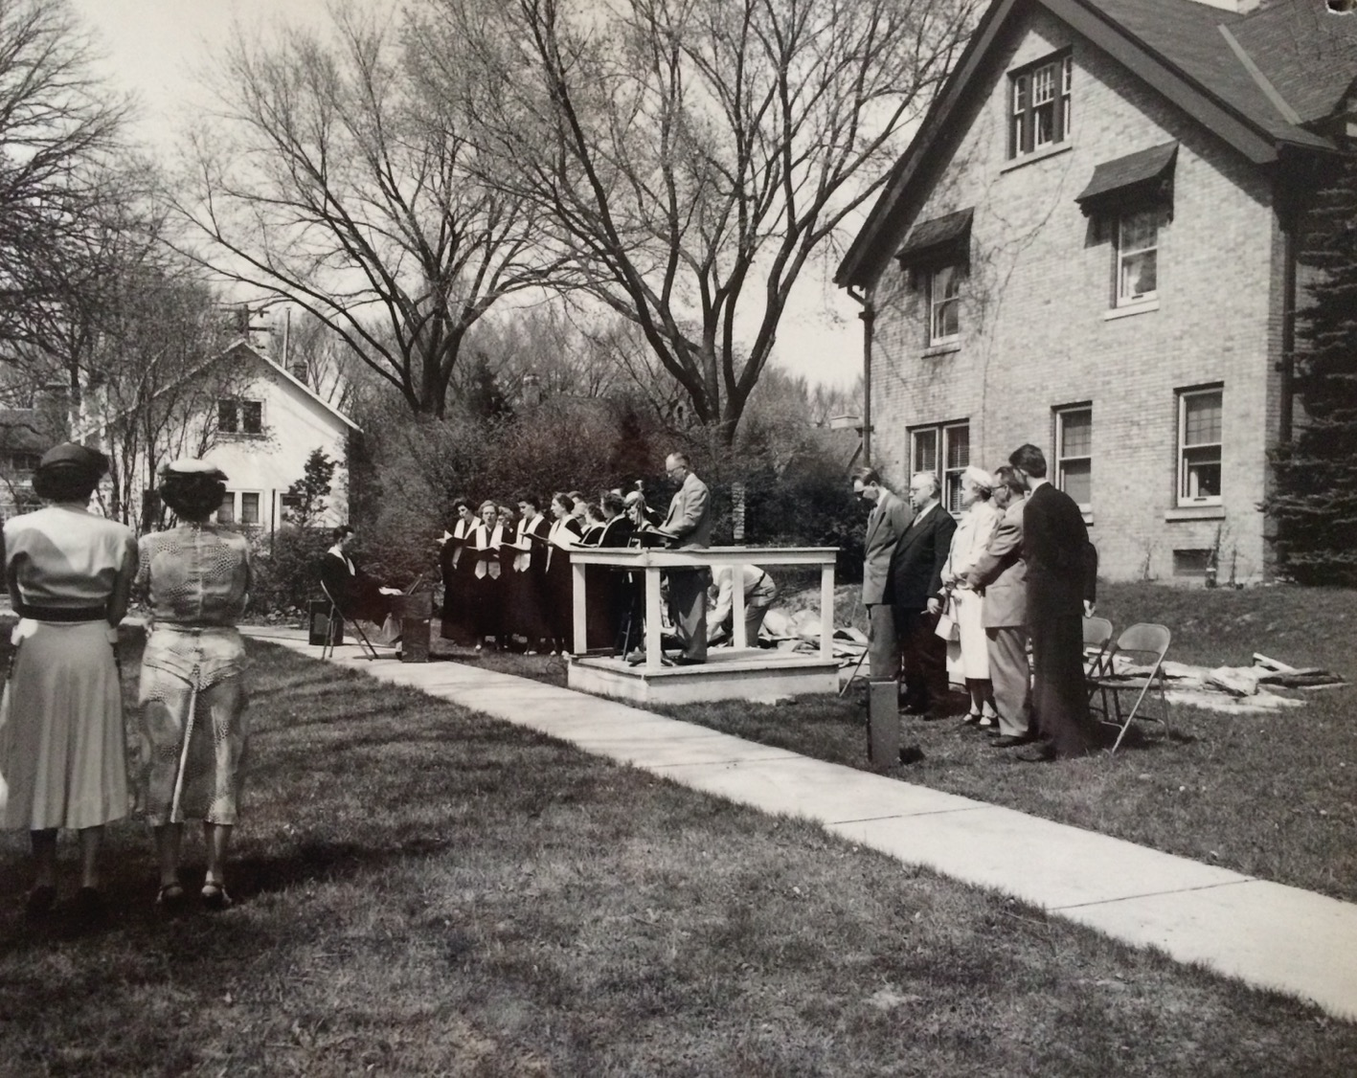
Groundbreaking May 9, 1953

Slide 37
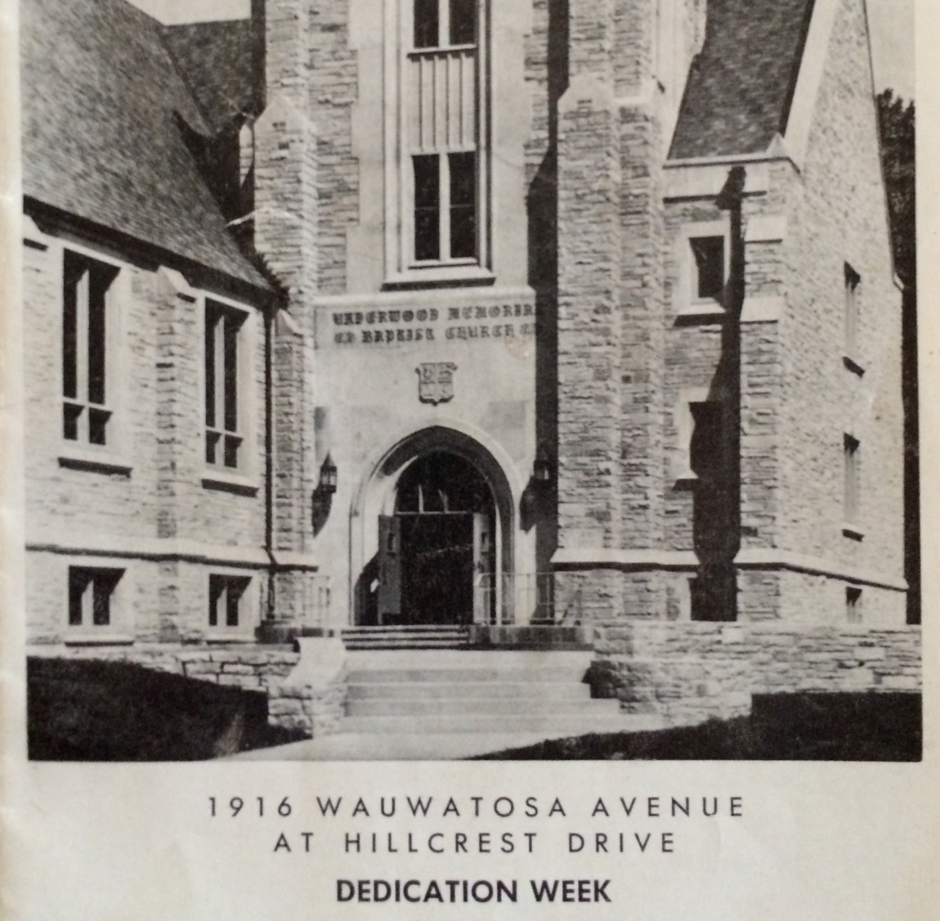
Dedication Week
September 12 – 19, 1954

Slide 38
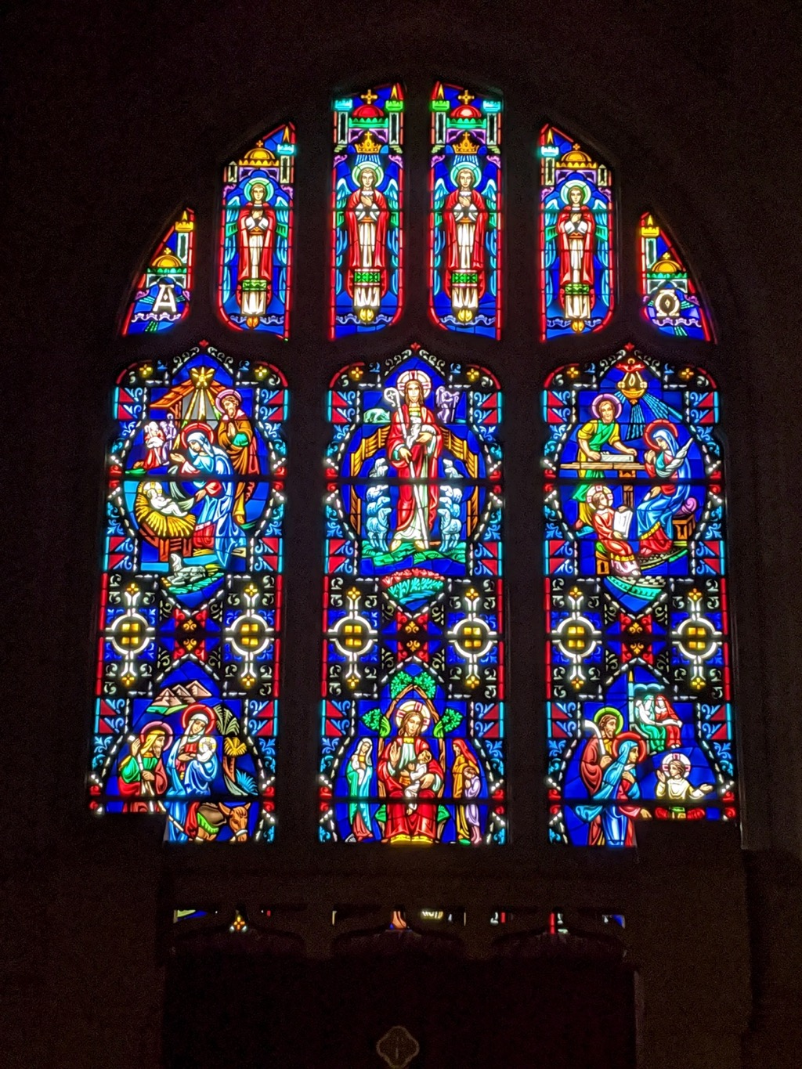
Stained glass window above the altar.

Slide 39
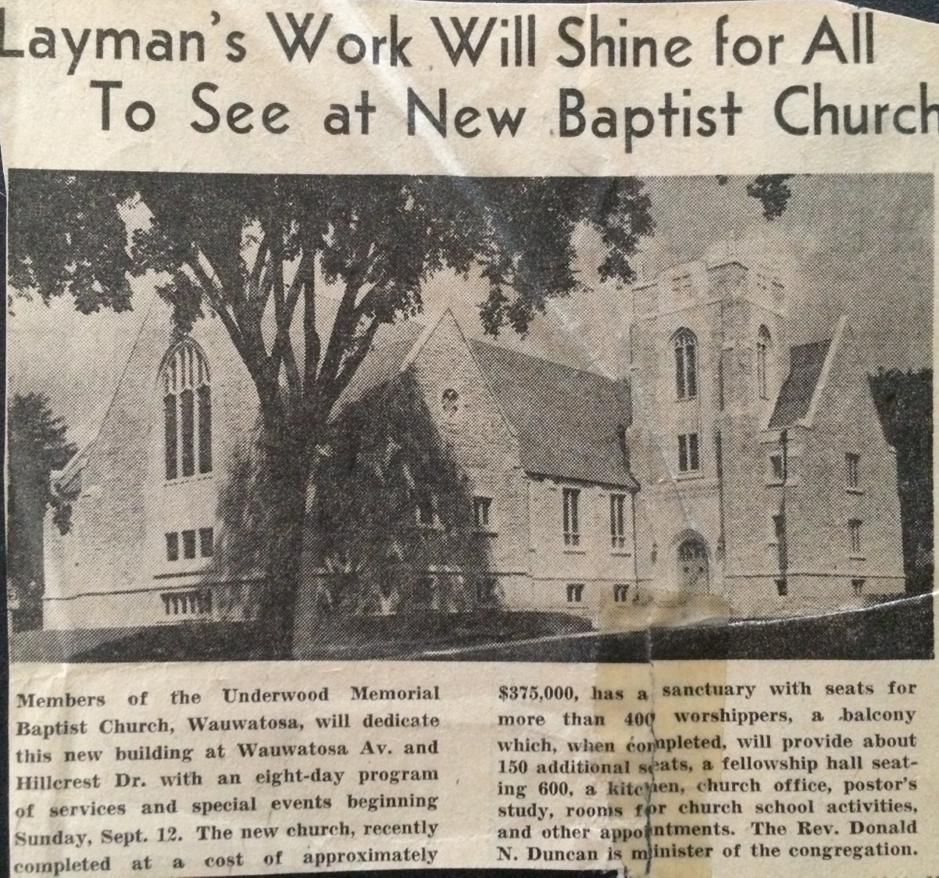
New building gets some attention.
Total Cost: $375,000

Slide 40
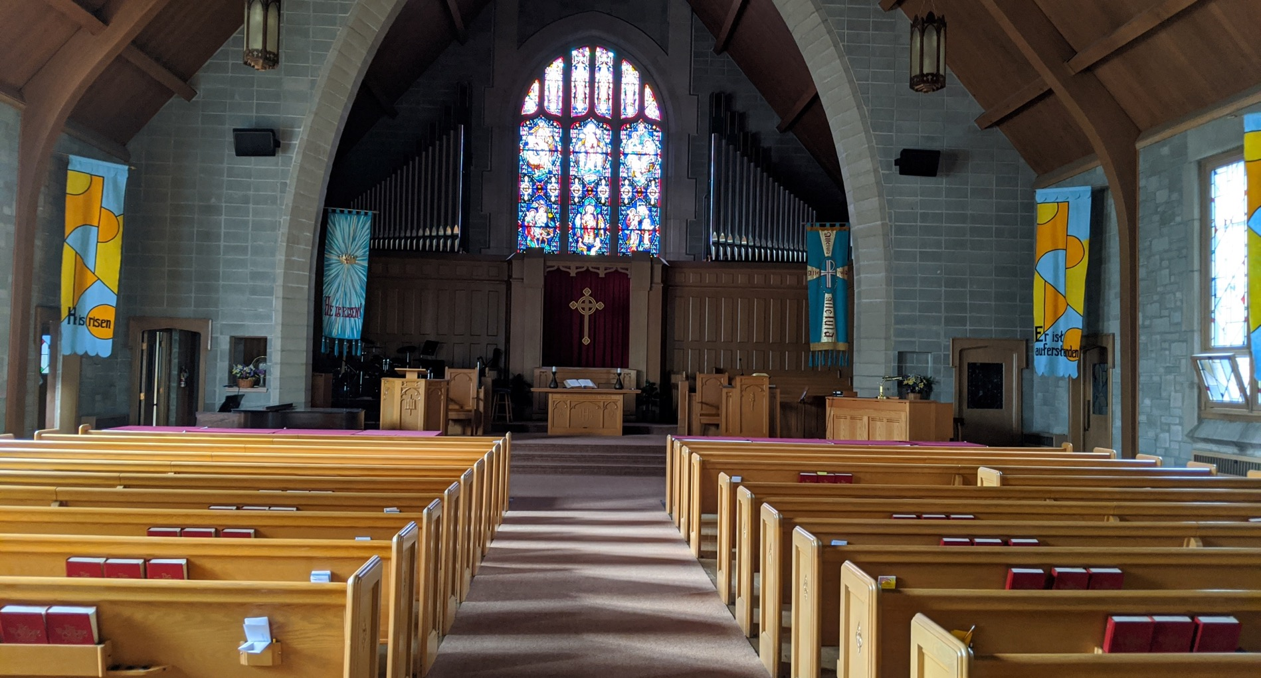

Slide 41
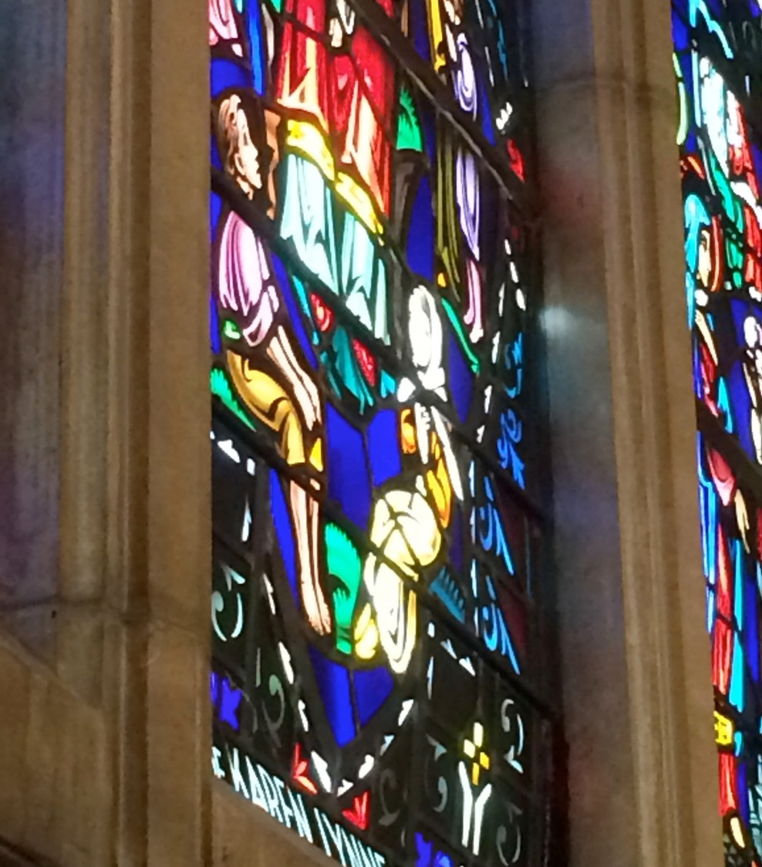
Window created in honor of Karen, killed 1955.

Slide 42
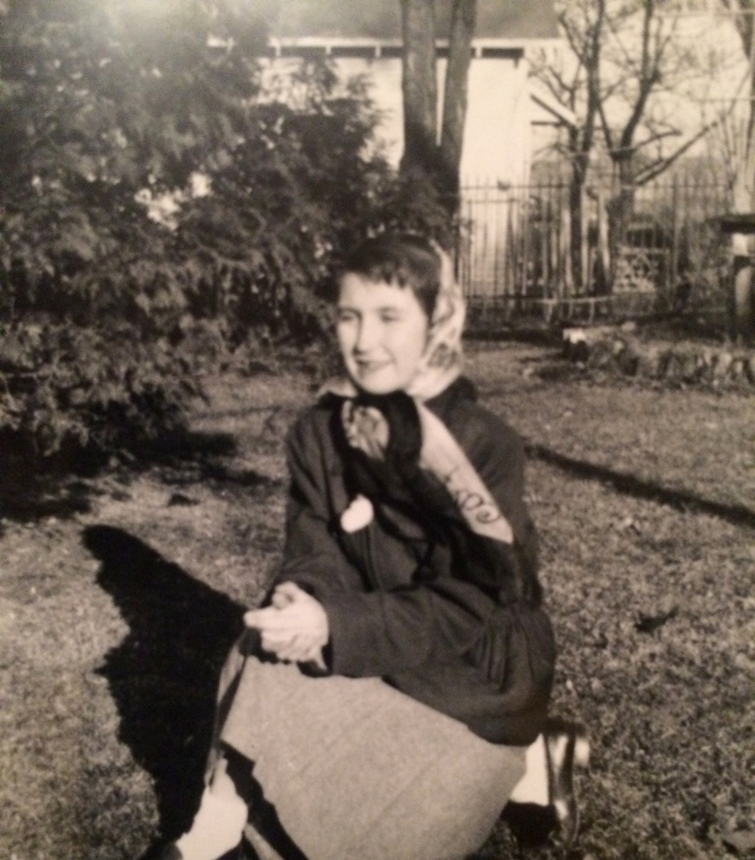
Photo of Karen, used for inspiration.

Slide 43
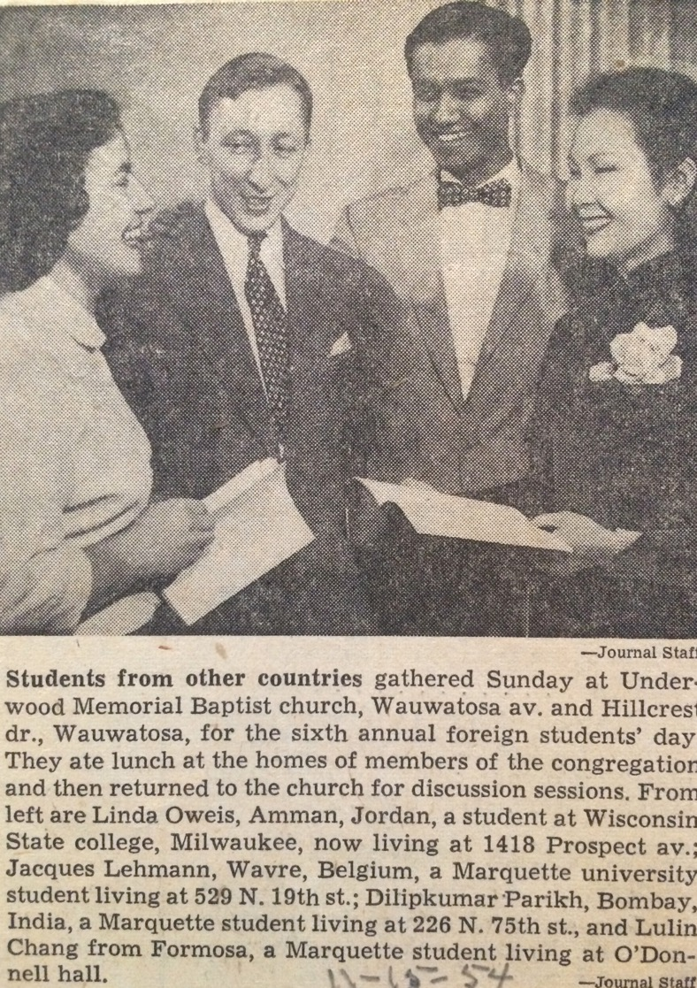
6th annual foreign students' day at Underwood, 1954.

Slide 44
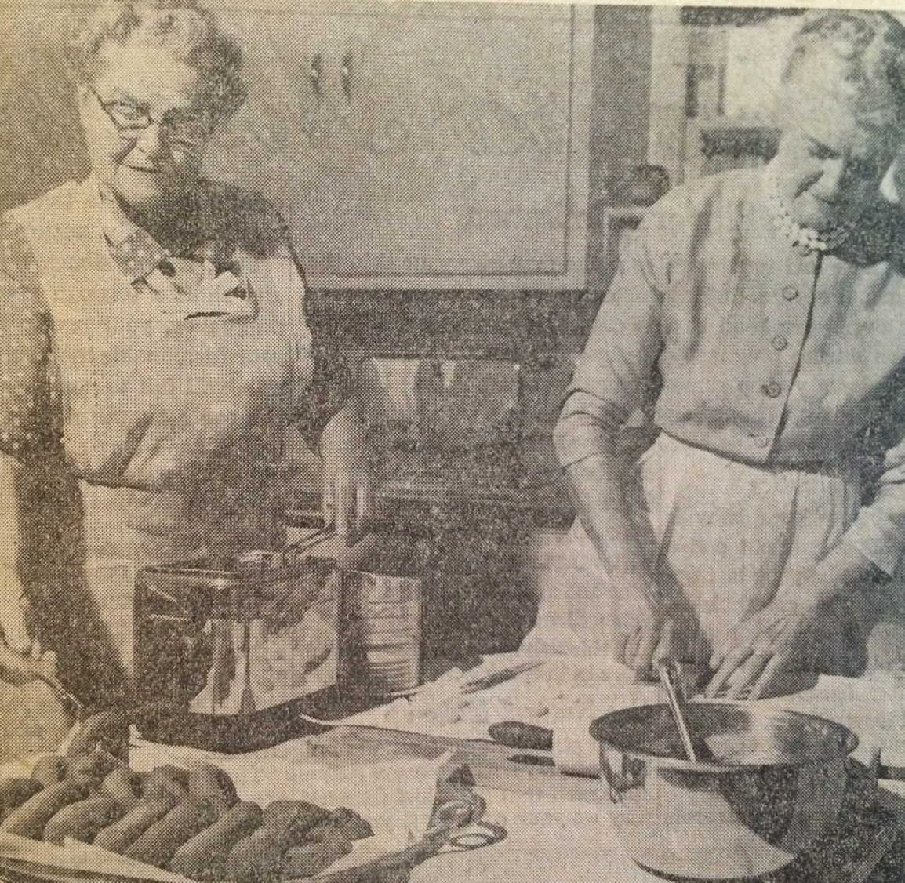
Making donuts for the 1955 bazar.

Slide 45
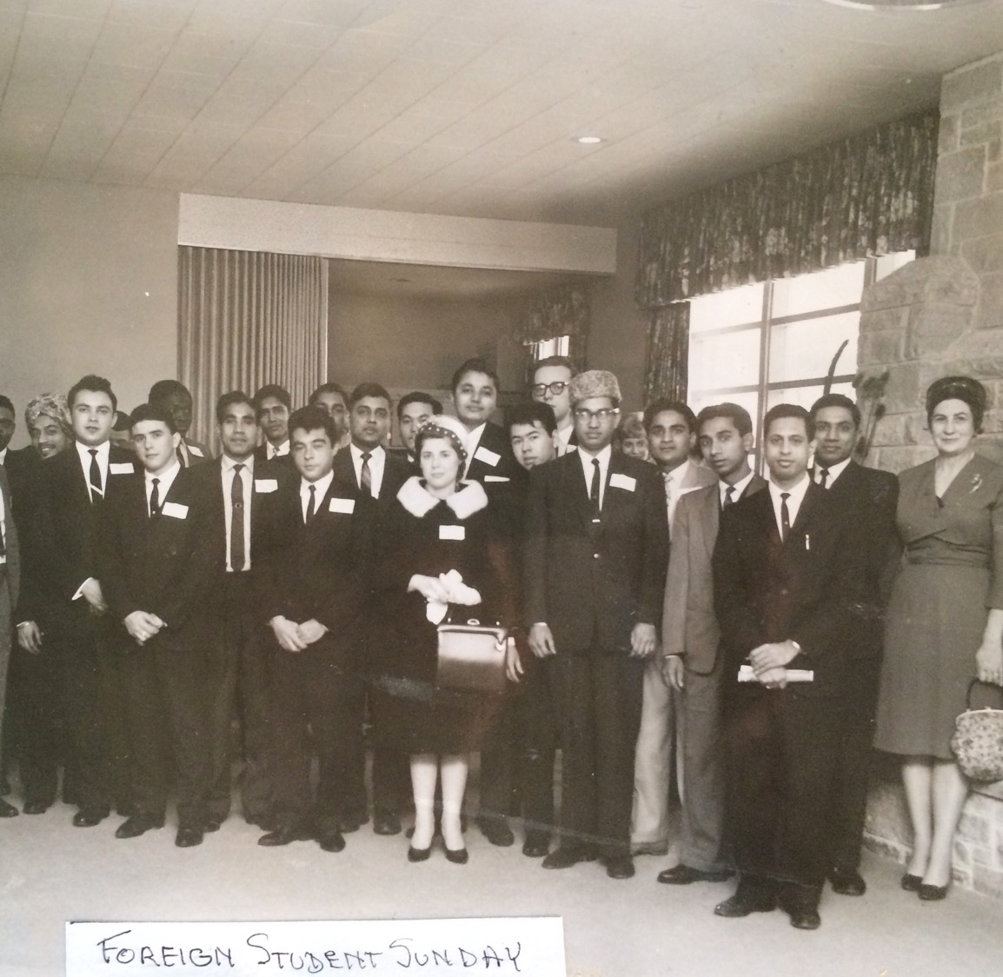
Foreign Student Sunday, 1955.

Slide 46
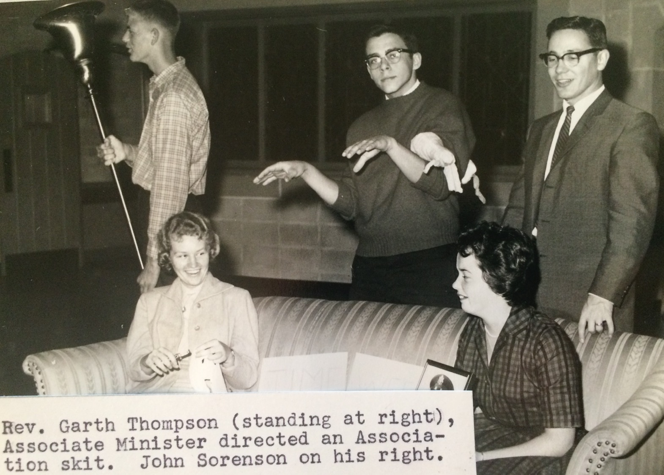
John Sorenson, 1960

Slide 47
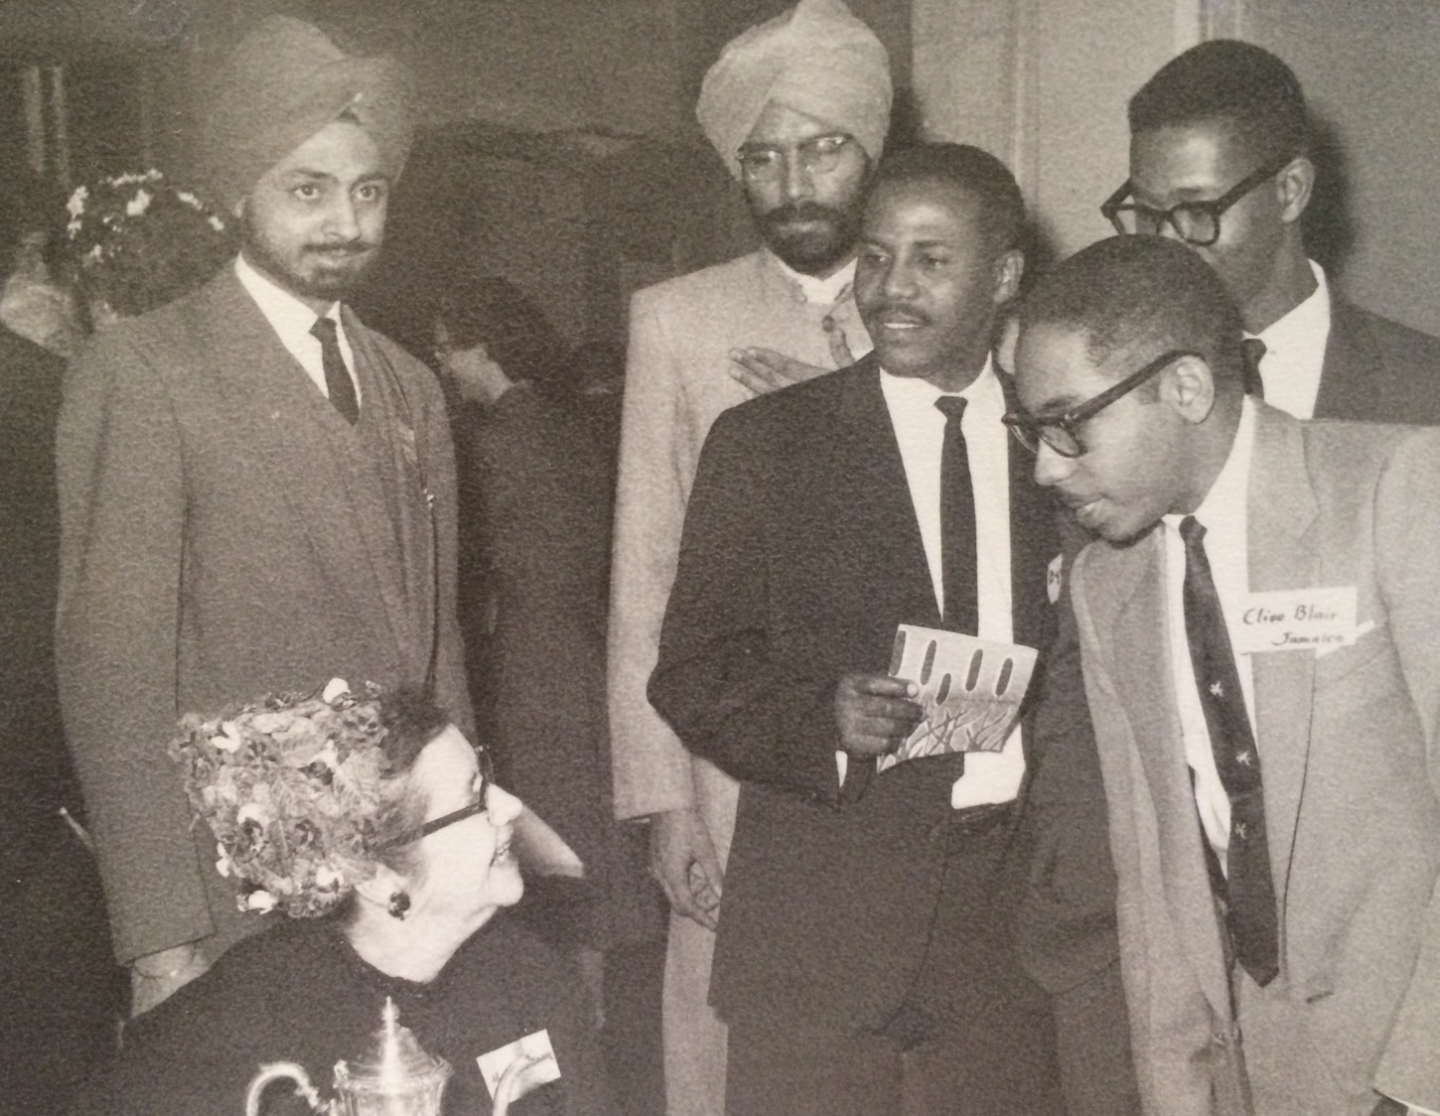
Foreign Student Day, 1962.

Slide 48
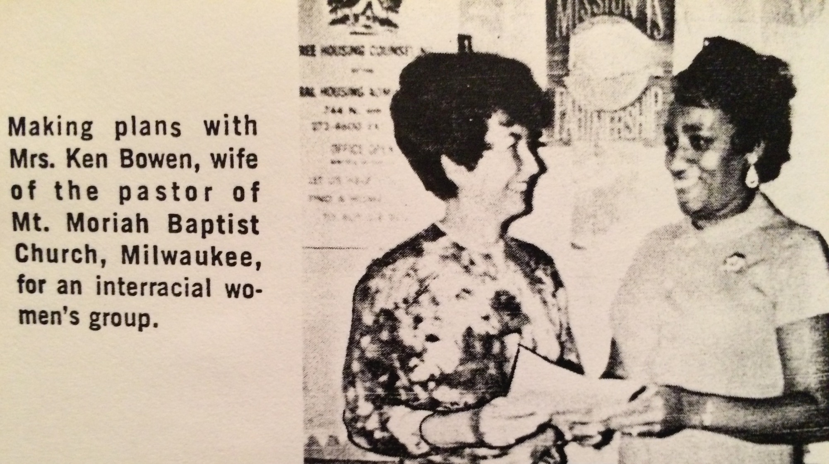
1967

Slide 49
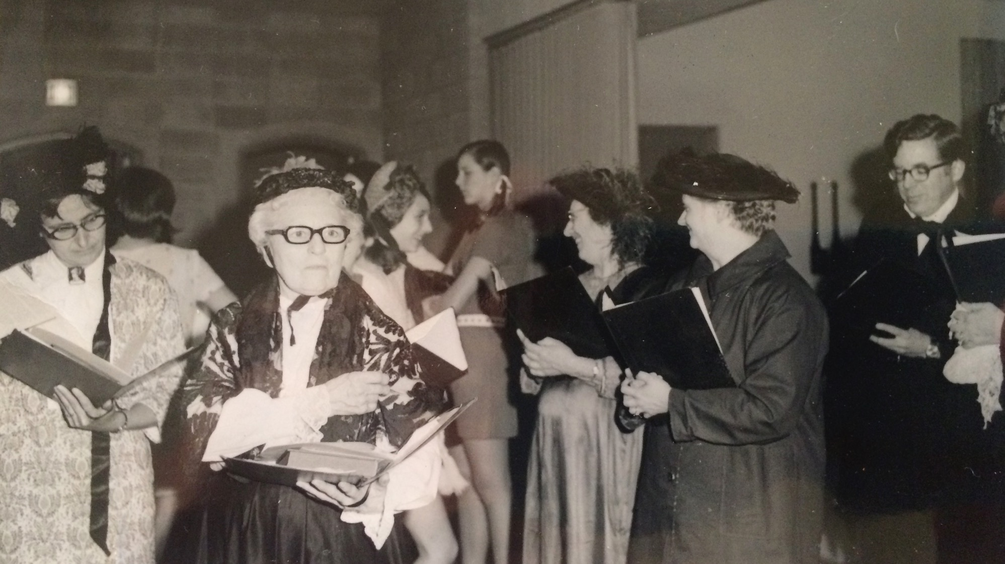
125th
anniversary
1970

Slide 50
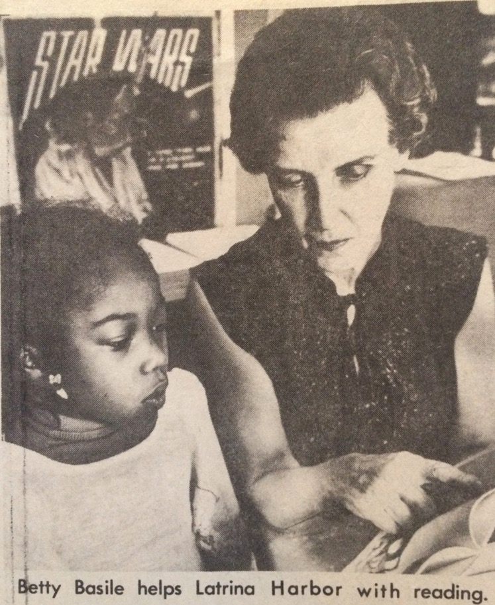
Underwood member, Betty Basile featured in the local news, 1980.

Slide 51
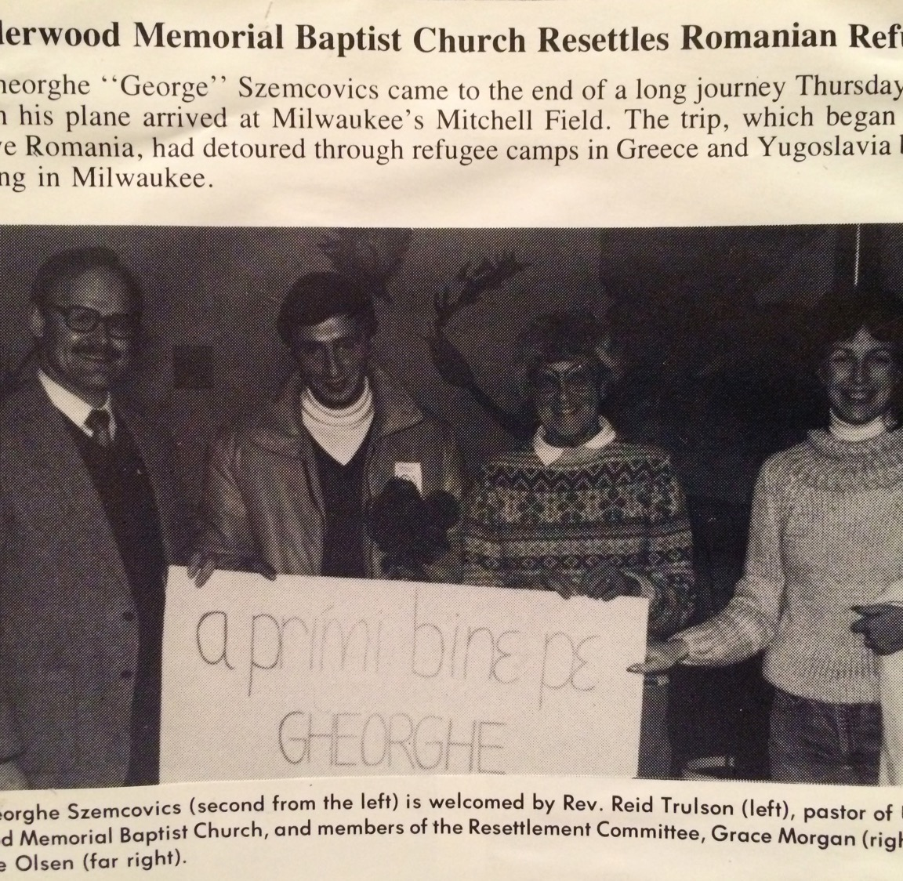
Resettling of Romanian Refugees, 1983.

Slide 52
Youth Group Reunion at Green Lake

Slide 53
Joint worship with Mount Moriah Baptist Church, 1986.

Slide 54
Bonnie Gleesing, Jean & Russell Yeager.
Round-robin Halloween party. Mid 80s

Slide 55
Banner for sister church in East Germany, 1988.

Slide 56
Laura Barrett, Mechelle Lynner, Bonnie Bell, Joan Johnson, Lyn Vertal.
June 25, 1989 - wedding of Kermit Smith & Janine

Slide 57
Neil Rosenow bobbing for apples, 1988.

Slide 58
1990

Slide 59
Duane Hand
1990

Slide 60
1990
Bonnie Sorenson
Eric Olsen

Slide 61
Hope
Marusic
2 & 3 Year Old Sunday School Class, 1990.

Slide 62
Mary Ann Hand
1st & 2nd Grade Sunday School, 1990.

Slide 63
5th & 6th Grade Sunday School, 1990.
Sarah Rosenow

Slide 64
In 1990, Underwood helped to resettle the Roberts Family who were political refugees from Liberia.

Slide 65
Sarah Rosenow receives the Youth Community Service Award, 1991.

Slide 76
Tip to Haiti
2006

Slide 80
Blessing of the Animals

Slide 84
Watering the new vegetable garden 2013

Slide 85
Christmas Eve 2017

Slide 86
Underwood’s sign addresses the issues of the day. Nov 2018.

Slide 87
Bells Sunday 2018

Slide 88
Pridefest 2018

Slide 90
Milwaukee Art Museum 2019

Slide 91
Easter Worship 2019

Slide 93
Newly refreshed historical cabinet
2020.

